Slide 1


Day:1 AI/ML for Beginners
Fundamentals of AI and ML with a hands-on approach using Python

Slide 2



Classification – Logistic Regression & Metrics
Tree-based Learning – Decision Trees
Nearest Neighbors – KNN
Unsupervised Learning – Clustering with K-Means
Intro to Neural Networks
Case Study
AGENDA

Slide 3
Regression-based Algorithms
According to Oracle, Regression is a data mining function to predict a number
It predicts output labels or replies, which are continuous numeric values, for the provided input data
The model's learning from the training phase will be used to determine the output
Regression models learn precise associations between inputs and outputs using the input data features (independent variables) and their matching continuous numeric output values (dependent or outcome variables)
‹#›

Slide 4
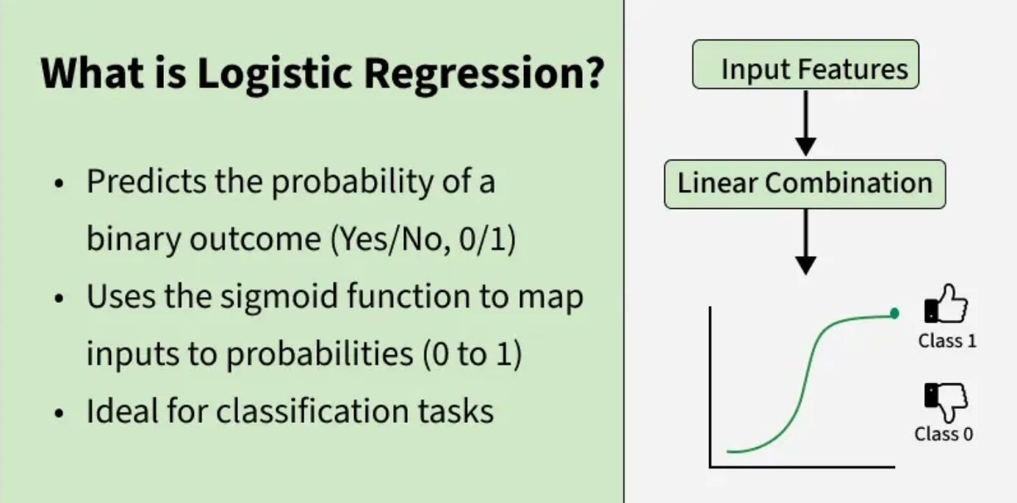
Logistic Regression
Logistic Regression is a supervised machine learning algorithm used for classification problems. Unlike linear regression which predicts continuous values it predicts the probability that an input belongs to a specific class.
Source: https://www.geeksforgeeks.org/machine-learning/understanding-logistic-regression/
Notes:
Content:
Not every GenAI idea is worth pursuing immediately. Use a 3-factor model:
🔢 1. ROI (Return on Investment)
Time saved per sprint
Reduction in delivery delays or defects
Value of insight gained
🧩 2. Complexity
Data requirements and integration effort
Workflow disruption and training needs
Tool/vendor dependency
✅ 3. Feasibility
Team maturity and skills
Existing tool compatibility
Governance and AI policy readiness
Use This Matrix:
Quick Wins – High ROI, low complexity (start here)
Strategic Bets – High ROI, high complexity (plan for scale)
Deprioritized – Low ROI, high complexity (low leverage)
Example Exercise:
Score the "automated release note generator":
ROI = High
Complexity = Medium
Feasibility = High
→ Prioritize for pilot

Slide 5
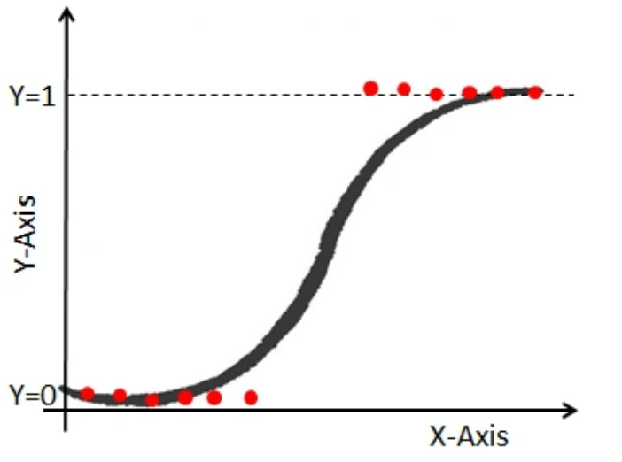
Logistic Regression (continued)
Despite the name, it’s a classification algorithm
It shares some properties with Linear Regression
It's a linear model, that is, it determine a linear combination of all the features using coefficients to scale each feature
The coefficients are what is being "learned".
Ultimately the model can be represented by a fairly simple mathematical function
Notes:
Content:
Not every GenAI idea is worth pursuing immediately. Use a 3-factor model:
🔢 1. ROI (Return on Investment)
Time saved per sprint
Reduction in delivery delays or defects
Value of insight gained
🧩 2. Complexity
Data requirements and integration effort
Workflow disruption and training needs
Tool/vendor dependency
✅ 3. Feasibility
Team maturity and skills
Existing tool compatibility
Governance and AI policy readiness
Use This Matrix:
Quick Wins – High ROI, low complexity (start here)
Strategic Bets – High ROI, high complexity (plan for scale)
Deprioritized – Low ROI, high complexity (low leverage)
Example Exercise:
Score the "automated release note generator":
ROI = High
Complexity = Medium
Feasibility = High
→ Prioritize for pilot

Slide 6
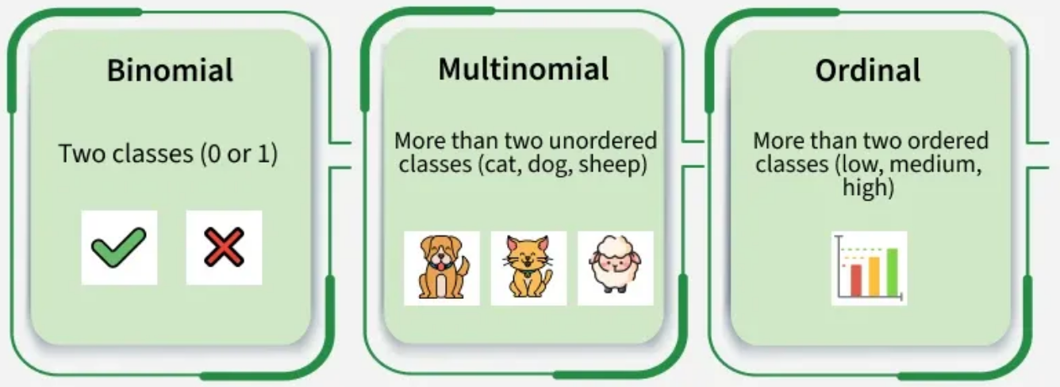
Types of Logistic Regression
Notes:
Content:
Not every GenAI idea is worth pursuing immediately. Use a 3-factor model:
🔢 1. ROI (Return on Investment)
Time saved per sprint
Reduction in delivery delays or defects
Value of insight gained
🧩 2. Complexity
Data requirements and integration effort
Workflow disruption and training needs
Tool/vendor dependency
✅ 3. Feasibility
Team maturity and skills
Existing tool compatibility
Governance and AI policy readiness
Use This Matrix:
Quick Wins – High ROI, low complexity (start here)
Strategic Bets – High ROI, high complexity (plan for scale)
Deprioritized – Low ROI, high complexity (low leverage)
Example Exercise:
Score the "automated release note generator":
ROI = High
Complexity = Medium
Feasibility = High
→ Prioritize for pilot

Slide 7
Linear VS Logistic Regression
Aspect | Linear Regression | Logistic Regression
Primary Purpose | Used to predict continuous numerical values | Used to predict categorical outcomes (classification)
Type of Output | Produces a continuous value | Produces a probability between 0 and 1
Example Use Case | Predicting house prices, temperature, sales | Spam detection, disease prediction, customer churn
Final Decision | Output itself is the final prediction | Probability is converted to a class using a threshold
Problem Type | Regression problem | Classification problem
Output Range | (-∞ to +∞) | 0 to 1
Model Behavior | Fits a straight line to data | Uses an S-shaped (sigmoid) curve to map probability
Notes:
Content:
Not every GenAI idea is worth pursuing immediately. Use a 3-factor model:
🔢 1. ROI (Return on Investment)
Time saved per sprint
Reduction in delivery delays or defects
Value of insight gained
🧩 2. Complexity
Data requirements and integration effort
Workflow disruption and training needs
Tool/vendor dependency
✅ 3. Feasibility
Team maturity and skills
Existing tool compatibility
Governance and AI policy readiness
Use This Matrix:
Quick Wins – High ROI, low complexity (start here)
Strategic Bets – High ROI, high complexity (plan for scale)
Deprioritized – Low ROI, high complexity (low leverage)
Example Exercise:
Score the "automated release note generator":
ROI = High
Complexity = Medium
Feasibility = High
→ Prioritize for pilot

Slide 8
How are we doing? Metrics...
There are many ways to measure our model’s performance
Two common metrics are precision and recall
Helpful to think in terms of items return via a search:
  Precision = how many presented items are relevant?
  Recall = how many relevant items were presented?
Notes:
Content:
Not every GenAI idea is worth pursuing immediately. Use a 3-factor model:
🔢 1. ROI (Return on Investment)
Time saved per sprint
Reduction in delivery delays or defects
Value of insight gained
🧩 2. Complexity
Data requirements and integration effort
Workflow disruption and training needs
Tool/vendor dependency
✅ 3. Feasibility
Team maturity and skills
Existing tool compatibility
Governance and AI policy readiness
Use This Matrix:
Quick Wins – High ROI, low complexity (start here)
Strategic Bets – High ROI, high complexity (plan for scale)
Deprioritized – Low ROI, high complexity (low leverage)
Example Exercise:
Score the "automated release note generator":
ROI = High
Complexity = Medium
Feasibility = High
→ Prioritize for pilot

Slide 9
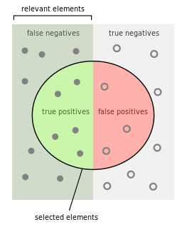
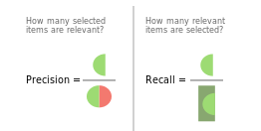
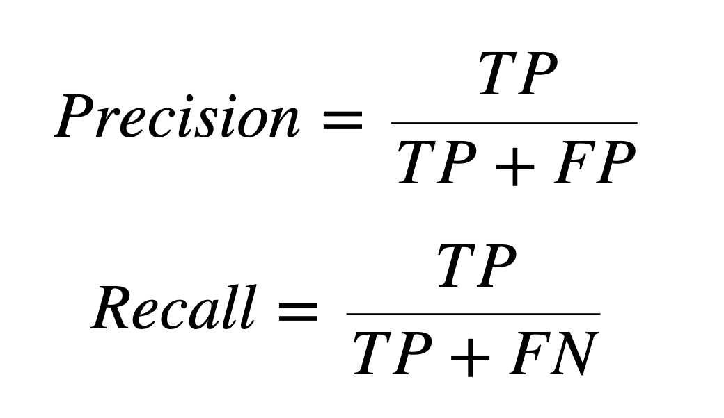
Precision vs. Recall
In what kind of real-world system would we prefer recall over precision?
Notes:
Content:
Not every GenAI idea is worth pursuing immediately. Use a 3-factor model:
🔢 1. ROI (Return on Investment)
Time saved per sprint
Reduction in delivery delays or defects
Value of insight gained
🧩 2. Complexity
Data requirements and integration effort
Workflow disruption and training needs
Tool/vendor dependency
✅ 3. Feasibility
Team maturity and skills
Existing tool compatibility
Governance and AI policy readiness
Use This Matrix:
Quick Wins – High ROI, low complexity (start here)
Strategic Bets – High ROI, high complexity (plan for scale)
Deprioritized – Low ROI, high complexity (low leverage)
Example Exercise:
Score the "automated release note generator":
ROI = High
Complexity = Medium
Feasibility = High
→ Prioritize for pilot

Slide 10
Hypothetical COVID Identification System
For airports and other locations where people gather
Guaranteed not to miss a single person with COVID
Here it is…
  Are you ready?
    Everyone has COVID!
ANALYSIS: We didn’t miss a single person with COVID
PROBLEM: Too many false positives
Let's say there are 5M people with COVID in the
USA at any given time…
  Our system identified all, but not very precise!
  Recall is a function of how many we got right–
  we got all 5M who are sick so recall was great!
Notes:
Content:
Not every GenAI idea is worth pursuing immediately. Use a 3-factor model:
🔢 1. ROI (Return on Investment)
Time saved per sprint
Reduction in delivery delays or defects
Value of insight gained
🧩 2. Complexity
Data requirements and integration effort
Workflow disruption and training needs
Tool/vendor dependency
✅ 3. Feasibility
Team maturity and skills
Existing tool compatibility
Governance and AI policy readiness
Use This Matrix:
Quick Wins – High ROI, low complexity (start here)
Strategic Bets – High ROI, high complexity (plan for scale)
Deprioritized – Low ROI, high complexity (low leverage)
Example Exercise:
Score the "automated release note generator":
ROI = High
Complexity = Medium
Feasibility = High
→ Prioritize for pilot

Slide 11
Other Metrics: MSE and MAE
MAE = Mean Absolute Error
MSE = Mean Squared Error
What do they “mean”?
When might we use them?
There are others, but our goal is not to delve into the mathy details, but rather, have a high-level understand of some of these metrics
Notes:
Content:
Not every GenAI idea is worth pursuing immediately. Use a 3-factor model:
🔢 1. ROI (Return on Investment)
Time saved per sprint
Reduction in delivery delays or defects
Value of insight gained
🧩 2. Complexity
Data requirements and integration effort
Workflow disruption and training needs
Tool/vendor dependency
✅ 3. Feasibility
Team maturity and skills
Existing tool compatibility
Governance and AI policy readiness
Use This Matrix:
Quick Wins – High ROI, low complexity (start here)
Strategic Bets – High ROI, high complexity (plan for scale)
Deprioritized – Low ROI, high complexity (low leverage)
Example Exercise:
Score the "automated release note generator":
ROI = High
Complexity = Medium
Feasibility = High
→ Prioritize for pilot

Slide 12

Evaluation Metrics: Is Accuracy Enough?
A system has to specify we have Dog or Not Dog within a set of pictures
One of the simple evaluation metrics is accuracy. Suppose you have 5 images and the model gets 4 of them right, then the score is 0.8
Thus, we can say accuracy is the number of correctly classified images over total images. That is simple and intuitive, but this is not enough
‹#›

Slide 13
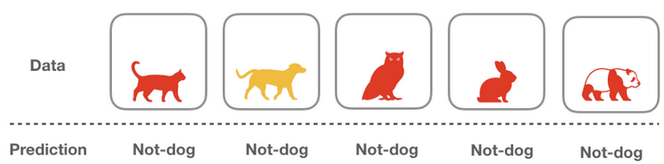
Evaluation Metrics: Is Accuracy Enough?
Let’s create an algorithm
  def is_a_dog (x):
      return False
The naive algorithm above assumes everything is not a dog without doing any computation on the given data
One thing to notice is that because coincidentally our dataset has 4 images that are not-dog, such naive algorithm gets the score of 0.8 (so called accuracy)
‹#›

Slide 14
Evaluation Metrics: Is Accuracy Enough?
Here we are having the Class Imbalance Problem
It will lead you to failure of Accuracy
‹#›

Slide 15
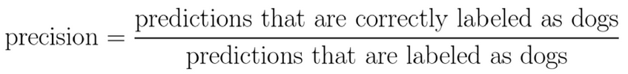

Evaluation Metrics: Other metrics to look for
Ways to combat this situation:
  Precision: Among all of the predictions that are “dog”, how many of them are correctly classified?
  Recall: Among all of data that are labelled “dog”, how many of them are correctly classified?
‹#›

Slide 16

Evaluation Metrics: Other metrics to look for
At Airport, What is required? Accuracy or Precision?
‹#›

Slide 17

Evaluation Metrics: Other metrics to look for
In Courtroom, What is required? Accuracy or Precision?
‹#›

Slide 18
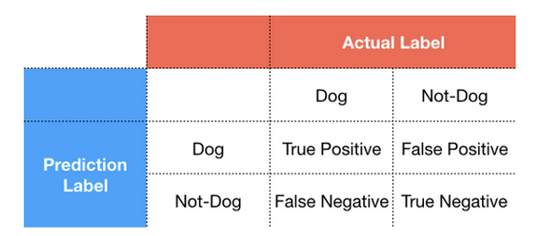
Evaluation Metrics: Other metrics to look for
Let’s create a Confusion Matrix
  A Confusion matrix splits the data into 4 categories: true positive, true negative, false positive and false negative
‹#›

Slide 19
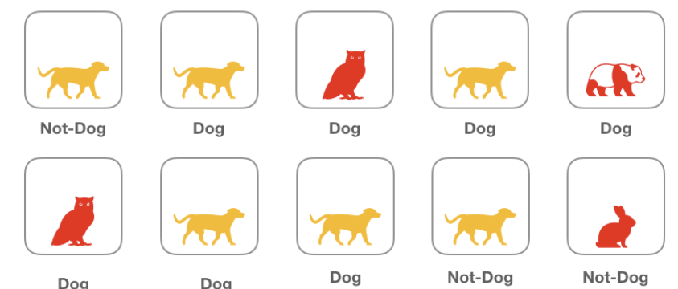
Evaluation Metrics: Other metrics to look for
Let’s consider a batch of images labelled as Dog and Not-Dog:
‹#›

Slide 20
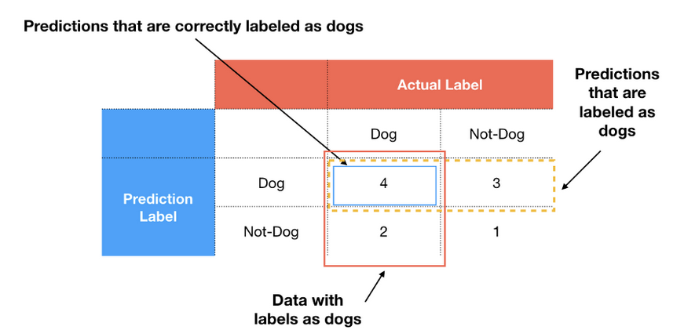
Evaluation Metrics: Other metrics to look for
Now evaluate it using Confusion Matrix
In this case, the Precision is (4/(4+3))= 0.57 whereas recall is (4/(4+2))= 0.66
‹#›

Slide 21
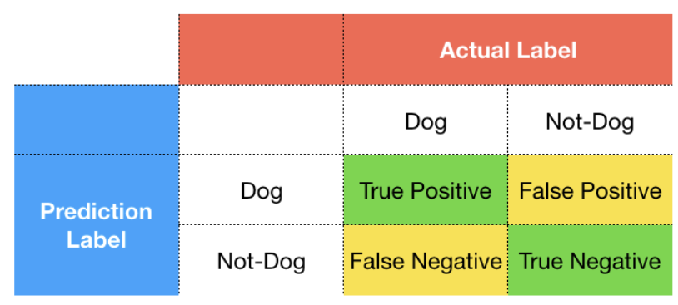
Evaluation Metrics: Other metrics to look for
How to decide Precision or Recall?
‹#›

Slide 22
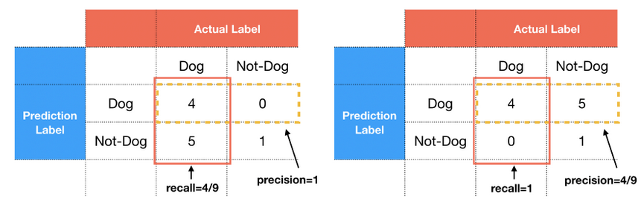
Evaluation Metrics: Other metrics to look for
Suppose our model will surely have 5 incorrect labels, if all the incorrect classifications fall into false-positive, then we will have low precision and high recall
However, if the incorrect labels fall into false-negative, we will instead have high precision and low recall
‹#›

Slide 23
Evaluation Metrics: Other metrics to look for
Therefore, when you train your machine learning model, you must decide which metrics is more important.
If we were asked to build a model for financial institution where we want to classify whether the borrower is a good candidate or not, we may prefer our model not to give the loan recklessly
Therefore, we rather classify the good people as bad people (false negative) rather than to classify the bad people as good one (false positive)
In other word, false negatives (high recall) is more preferable than the false positives (high precision)
‹#›

Slide 24
Classification – Logistic Regression & Metrics
Tree-based Learning – Decision Trees
Nearest Neighbors – KNN
Unsupervised Learning – Clustering with K-Means
Intro to Neural Networks
Case Study
AGENDA

Slide 25
Tree-based Algorithms
One of the greatest and most popular supervised learning techniques is based on tree-based algorithms
Predictive models are strengthened by tree-based algorithms because of their excellent accuracy, stability, and simplicity
They can adjust to any situation and find a solution to any issue (classification or regression)
In many types of data science challenges, tree-based techniques including gradient boosting, random forest, and decision trees are frequently used
‹#›

Slide 26
Tree based Algorithm - Types
Decision Tree
A graphical representation of possible solutions to decision based on certain conditions
Bagging
Ensemble meta-algorithm combining predictions from multiple decision trees through a majority voting mechanism
Random Forest
Bagging based algorithm where only a subset of features are selected at random to build a forest or collection of decision trees
Boosting
Models are build sequentially by minimizing the errors from previous models while increasing influence of high performing models
Gradient Boosting
Employs gradient descent algorithms to minimize errors in sequential models
XGBoost
Optimized gradient boosting algorithm through parallel processing, tree pruning, handling missing values & regularization to avoid overfitting/bias
‹#›

Slide 27
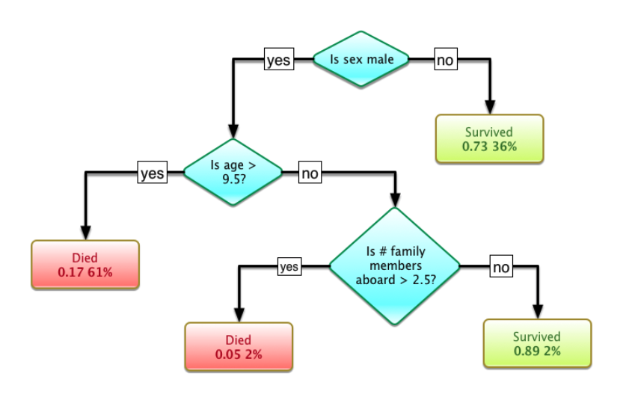
Decision Trees
Tree-based classifier (like a bunch of if-then statements)
Models relationships between features and targets
Notes:
Content:
Not every GenAI idea is worth pursuing immediately. Use a 3-factor model:
🔢 1. ROI (Return on Investment)
Time saved per sprint
Reduction in delivery delays or defects
Value of insight gained
🧩 2. Complexity
Data requirements and integration effort
Workflow disruption and training needs
Tool/vendor dependency
✅ 3. Feasibility
Team maturity and skills
Existing tool compatibility
Governance and AI policy readiness
Use This Matrix:
Quick Wins – High ROI, low complexity (start here)
Strategic Bets – High ROI, high complexity (plan for scale)
Deprioritized – Low ROI, high complexity (low leverage)
Example Exercise:
Score the "automated release note generator":
ROI = High
Complexity = Medium
Feasibility = High
→ Prioritize for pilot

Slide 28
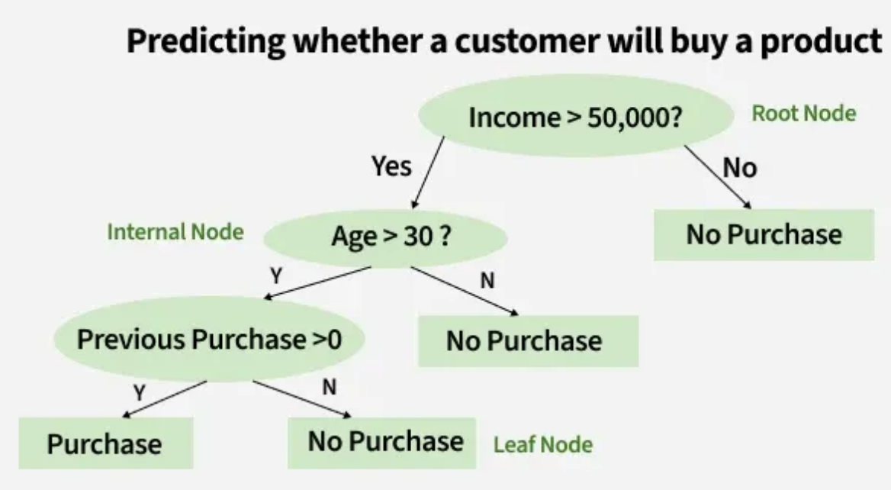
Decision Trees (continued)
Easy to explain to users
Can be turned into external representation (i.e., a picture)
Builds tree where each node divides the set of items based on the value of a feature
The feature and feature value are chosen based by which one "best" splits the set of items
Source: https://www.geeksforgeeks.org/machine-learning/decision-tree-introduction-example/
Notes:
Content:
Not every GenAI idea is worth pursuing immediately. Use a 3-factor model:
🔢 1. ROI (Return on Investment)
Time saved per sprint
Reduction in delivery delays or defects
Value of insight gained
🧩 2. Complexity
Data requirements and integration effort
Workflow disruption and training needs
Tool/vendor dependency
✅ 3. Feasibility
Team maturity and skills
Existing tool compatibility
Governance and AI policy readiness
Use This Matrix:
Quick Wins – High ROI, low complexity (start here)
Strategic Bets – High ROI, high complexity (plan for scale)
Deprioritized – Low ROI, high complexity (low leverage)
Example Exercise:
Score the "automated release note generator":
ROI = High
Complexity = Medium
Feasibility = High
→ Prioritize for pilot

Slide 29
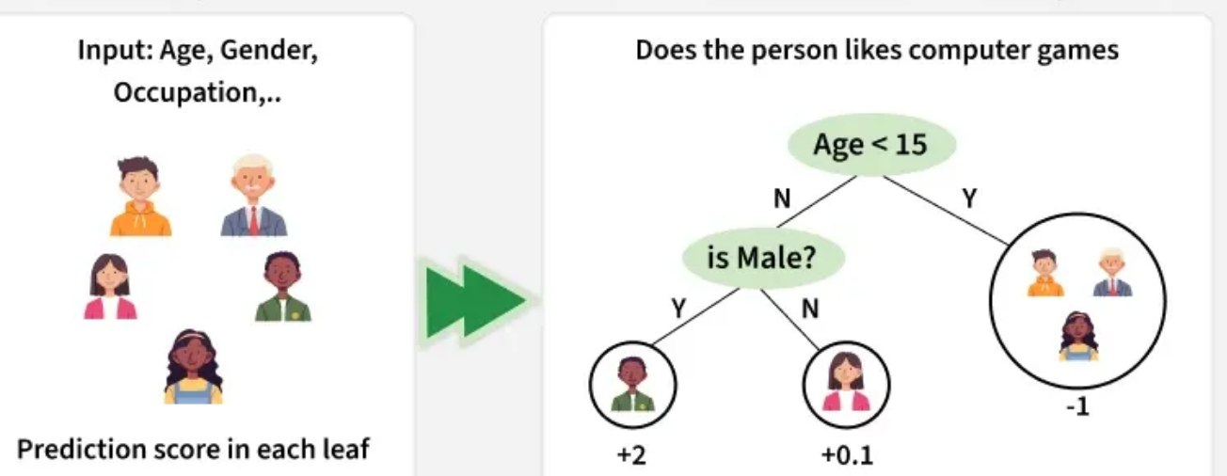
Working of Decision Trees
The model checks conditions like age and gender to split users into groups. Each group (leaf node) gets a prediction score based on user preferences for computer games
Source: https://www.geeksforgeeks.org/machine-learning/decision-tree-introduction-example/
Notes:
Content:
Not every GenAI idea is worth pursuing immediately. Use a 3-factor model:
🔢 1. ROI (Return on Investment)
Time saved per sprint
Reduction in delivery delays or defects
Value of insight gained
🧩 2. Complexity
Data requirements and integration effort
Workflow disruption and training needs
Tool/vendor dependency
✅ 3. Feasibility
Team maturity and skills
Existing tool compatibility
Governance and AI policy readiness
Use This Matrix:
Quick Wins – High ROI, low complexity (start here)
Strategic Bets – High ROI, high complexity (plan for scale)
Deprioritized – Low ROI, high complexity (low leverage)
Example Exercise:
Score the "automated release note generator":
ROI = High
Complexity = Medium
Feasibility = High
→ Prioritize for pilot

Slide 30
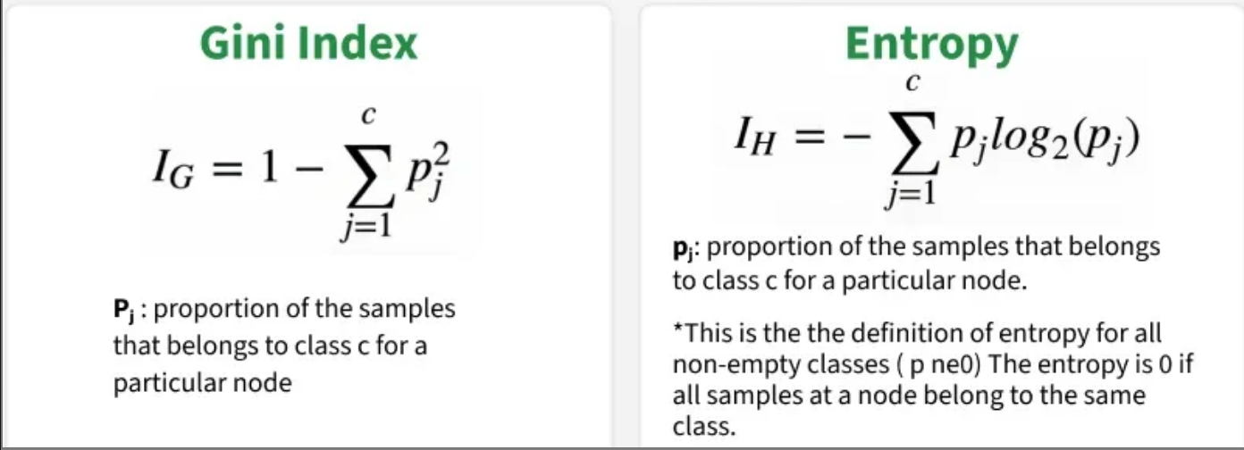
Splitting Criteria In Decision Trees (continued)
Source: https://www.geeksforgeeks.org/machine-learning/decision-tree-introduction-example/
Notes:
Content:
Not every GenAI idea is worth pursuing immediately. Use a 3-factor model:
🔢 1. ROI (Return on Investment)
Time saved per sprint
Reduction in delivery delays or defects
Value of insight gained
🧩 2. Complexity
Data requirements and integration effort
Workflow disruption and training needs
Tool/vendor dependency
✅ 3. Feasibility
Team maturity and skills
Existing tool compatibility
Governance and AI policy readiness
Use This Matrix:
Quick Wins – High ROI, low complexity (start here)
Strategic Bets – High ROI, high complexity (plan for scale)
Deprioritized – Low ROI, high complexity (low leverage)
Example Exercise:
Score the "automated release note generator":
ROI = High
Complexity = Medium
Feasibility = High
→ Prioritize for pilot

Slide 31
Information Gain in Decision Tree
1. Information Gain
Information Gain tells us how useful a question (or feature) is for splitting data into groups. It measures how much the uncertainty decreases after the split.
Suppose S is a set of instances A is an attribute, Sv is the subset of S, v represents an individual value that the attribute A can take and Values (A) is the set of all possible values of A then
Entropy: It is the measure of uncertainty of a random variable, it characterizes the impurity of an arbitrary collection of examples. The higher the entropy more the information content.
p
Notes:
Content:
Not every GenAI idea is worth pursuing immediately. Use a 3-factor model:
🔢 1. ROI (Return on Investment)
Time saved per sprint
Reduction in delivery delays or defects
Value of insight gained
🧩 2. Complexity
Data requirements and integration effort
Workflow disruption and training needs
Tool/vendor dependency
✅ 3. Feasibility
Team maturity and skills
Existing tool compatibility
Governance and AI policy readiness
Use This Matrix:
Quick Wins – High ROI, low complexity (start here)
Strategic Bets – High ROI, high complexity (plan for scale)
Deprioritized – Low ROI, high complexity (low leverage)
Example Exercise:
Score the "automated release note generator":
ROI = High
Complexity = Medium
Feasibility = High
→ Prioritize for pilot

Slide 32
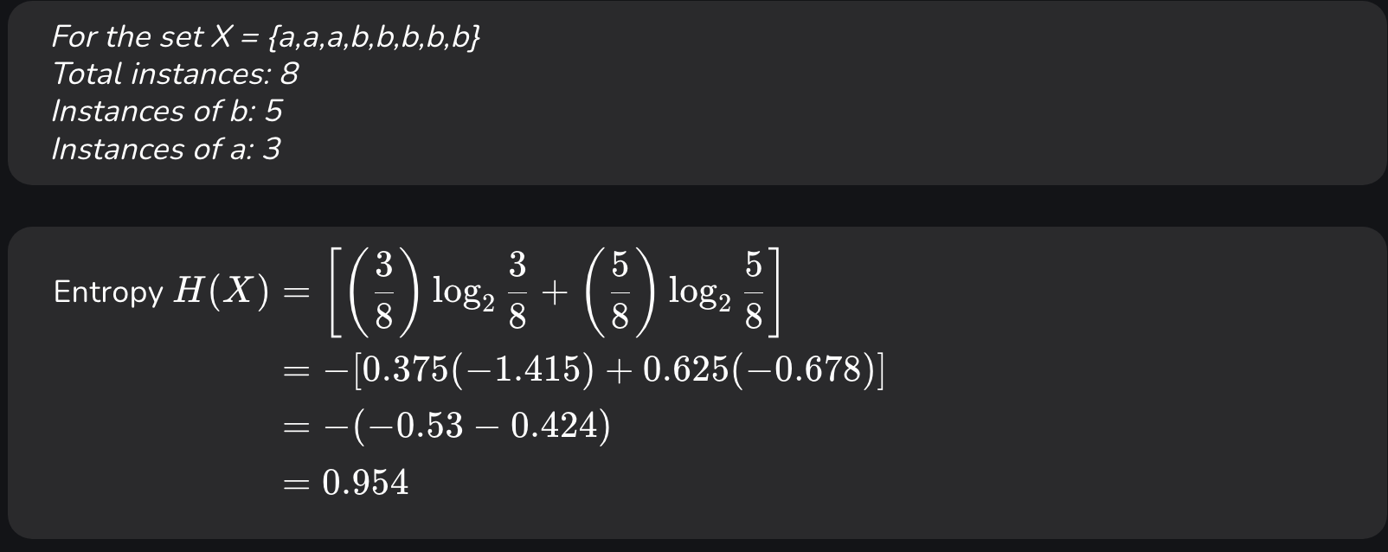
Information Gain in Decision Tree (continued)
Suppose S is a set of instances, A is an attribute, Sv is the subset of S with A= v and Values (A) is the set of all possible values of A, then
Example:
Notes:
Content:
Not every GenAI idea is worth pursuing immediately. Use a 3-factor model:
🔢 1. ROI (Return on Investment)
Time saved per sprint
Reduction in delivery delays or defects
Value of insight gained
🧩 2. Complexity
Data requirements and integration effort
Workflow disruption and training needs
Tool/vendor dependency
✅ 3. Feasibility
Team maturity and skills
Existing tool compatibility
Governance and AI policy readiness
Use This Matrix:
Quick Wins – High ROI, low complexity (start here)
Strategic Bets – High ROI, high complexity (plan for scale)
Deprioritized – Low ROI, high complexity (low leverage)
Example Exercise:
Score the "automated release note generator":
ROI = High
Complexity = Medium
Feasibility = High
→ Prioritize for pilot

Slide 33
Gini Index in Decision Tree
Gini Index is a metric to measure how often a randomly chosen element would be incorrectly identified. It means an attribute with a lower Gini index should be preferred. Sklearn supports “Gini” criteria for Gini Index and by default it takes “gini” value.
For example if we have a group of people where all bought the product (100% "Yes") the Gini Index is 0 indicate perfect purity. But if the group has an equal mix of "Yes" and "No" the Gini Index would be 0.5 show high impurity or uncertainty. Formula for Gini Index is given by :
Notes:
Content:
Not every GenAI idea is worth pursuing immediately. Use a 3-factor model:
🔢 1. ROI (Return on Investment)
Time saved per sprint
Reduction in delivery delays or defects
Value of insight gained
🧩 2. Complexity
Data requirements and integration effort
Workflow disruption and training needs
Tool/vendor dependency
✅ 3. Feasibility
Team maturity and skills
Existing tool compatibility
Governance and AI policy readiness
Use This Matrix:
Quick Wins – High ROI, low complexity (start here)
Strategic Bets – High ROI, high complexity (plan for scale)
Deprioritized – Low ROI, high complexity (low leverage)
Example Exercise:
Score the "automated release note generator":
ROI = High
Complexity = Medium
Feasibility = High
→ Prioritize for pilot

Slide 34
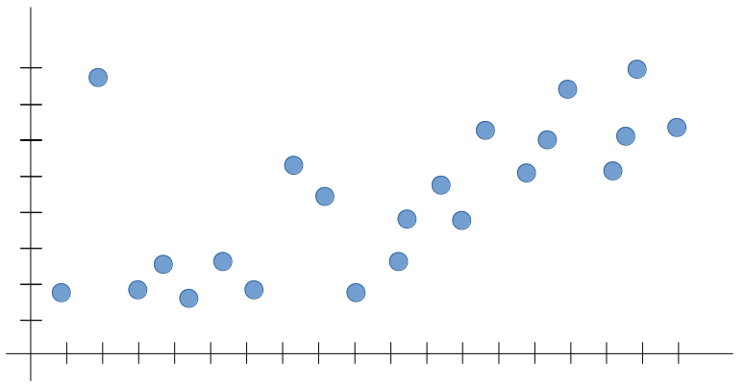
Bias vs Variance
Let’s say we’re trying to build a Machine Learning model for the following data set
‹#›

Slide 35
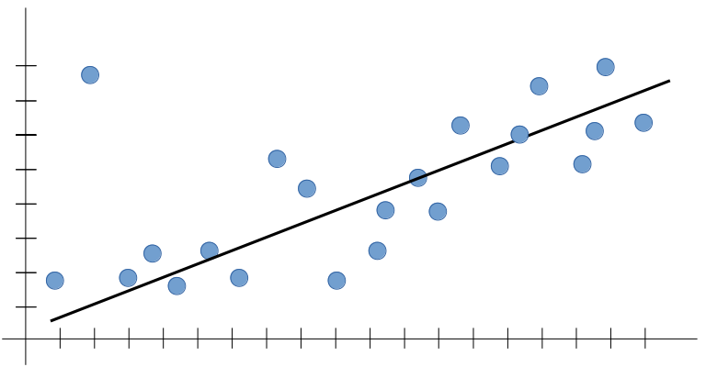
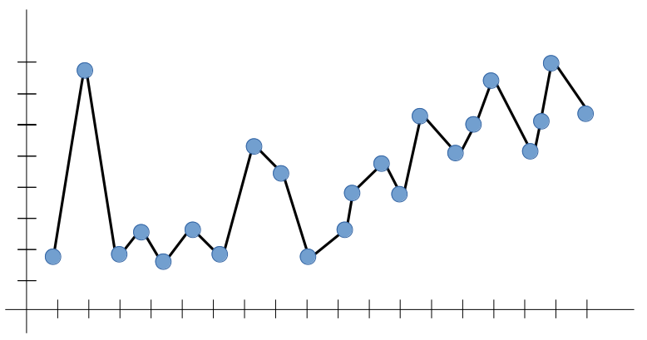
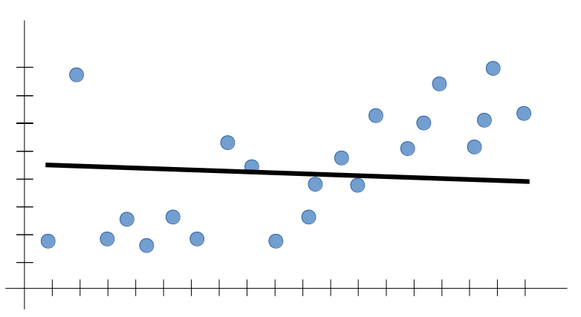
Bias vs Variance
A Good-Fit Model
Overfitting Model
Underfitting Model
In terms of Machine Learning, the line above could give a very likely prediction for any new input, The outputs are expected to follow the trend seen in the training set
Overfitting is the case where the overall cost is really small, but the generalization of the model is unreliable. This is due to the model having “learned too much” from the training data set
Underfitting is the case where the model has “not learned enough” from the training data, resulting in low-levels of generalization and unreliable predictions
‹#›

Slide 36
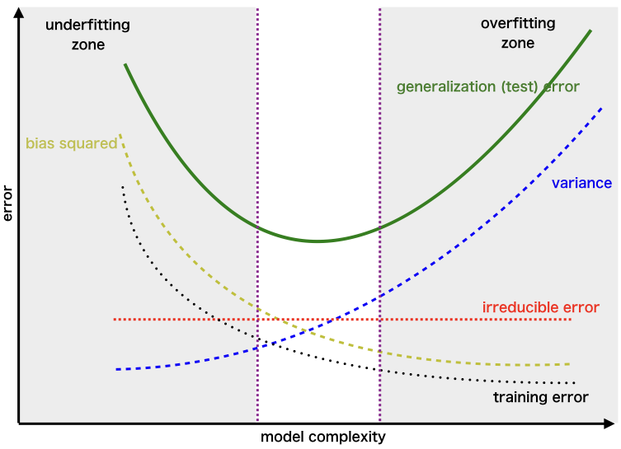
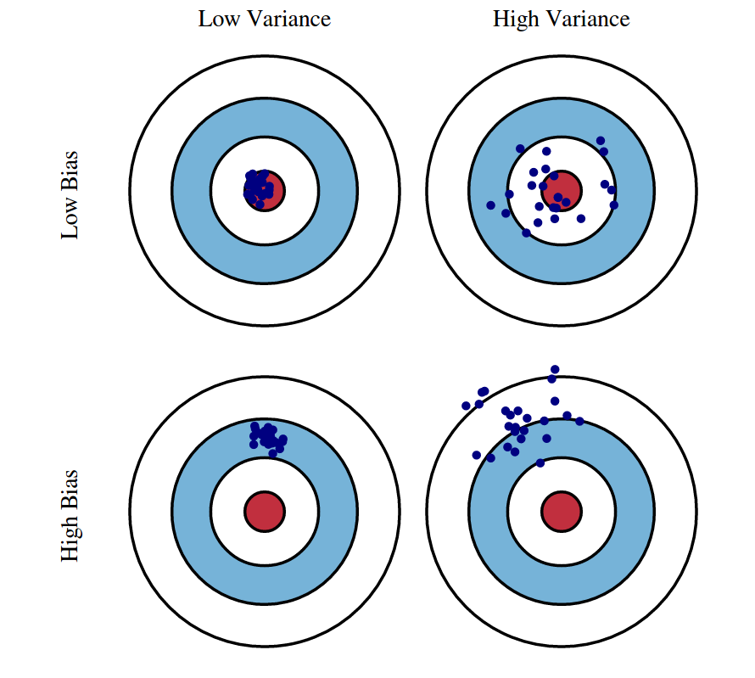
Bias vs Variance
Underfitting
Overfitting
‹#›

Slide 37
Classification – Logistic Regression & Metrics
Tree-based Learning – Decision Trees
Nearest Neighbors – KNN
Unsupervised Learning – Clustering with K-Means
Intro to Neural Networks
Case Study
AGENDA

Slide 38
Instance-based Algorithms
Instance-based learning is a family of learning algorithms that compares new issue instances with cases seen during training that have been retained in memory, as opposed to conducting explicit generalization
These algorithms are commonly referred to as "lazy" since computation is delayed until a new instance is observed
It is called instance-based because it constructs hypotheses directly from the training instances themselve
Examples of instance-based learning algorithms are the K-nearest neighbors (KNN) algorithm, Kernel Machines and RBF networks
‹#›

Slide 39
Instance based Algorithm - Types
Types of Instance based Algorithms
K Nearest Neighbour
Self Organizing Map
Learning Vector Quantization
Locally Weighted Learning
‹#›

Slide 40
Next algorithm: k-Nearest Neighbors (kNN)
k-NN Classification
  output is class membership
  object is classified by a majority vote of its neighbors
  for k = 1, then the object is simply assigned to the
  class of that single nearest neighbor
k-NN Regression
  output is the property value for the object
  this value is the average of the values of its k
  nearest neighbors
Notes:
Content:
Not every GenAI idea is worth pursuing immediately. Use a 3-factor model:
🔢 1. ROI (Return on Investment)
Time saved per sprint
Reduction in delivery delays or defects
Value of insight gained
🧩 2. Complexity
Data requirements and integration effort
Workflow disruption and training needs
Tool/vendor dependency
✅ 3. Feasibility
Team maturity and skills
Existing tool compatibility
Governance and AI policy readiness
Use This Matrix:
Quick Wins – High ROI, low complexity (start here)
Strategic Bets – High ROI, high complexity (plan for scale)
Deprioritized – Low ROI, high complexity (low leverage)
Example Exercise:
Score the "automated release note generator":
ROI = High
Complexity = Medium
Feasibility = High
→ Prioritize for pilot

Slide 41
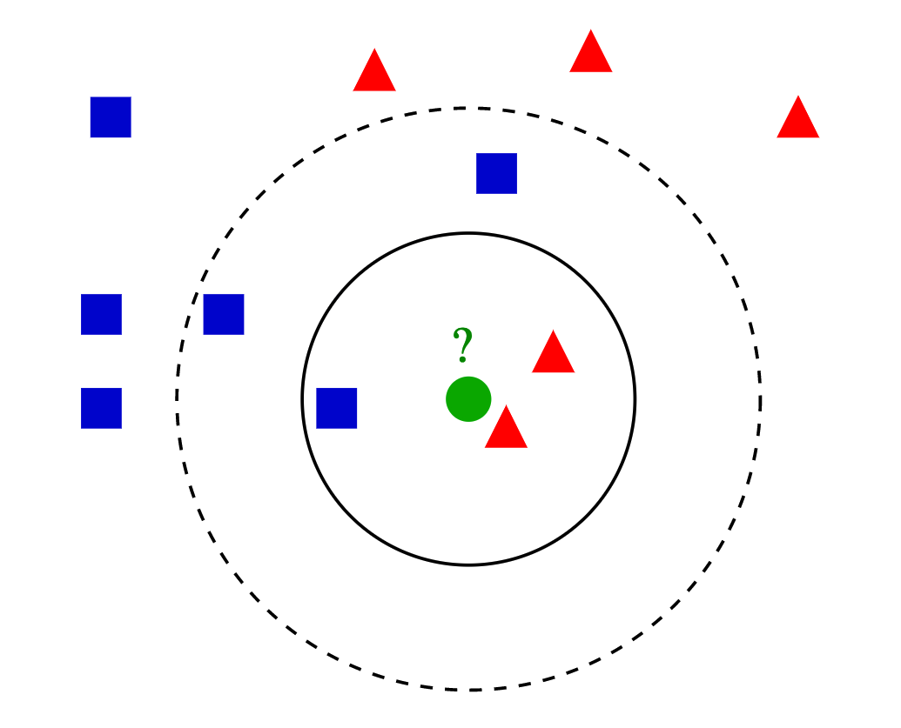
k-Nearest Neighbors (kNN)
Green dot is unknown, i.e., is it a red triangle or a blue square?
Pick a k, and look at that many nearest neighbors
What if k = 3?
What if k = 5?
Notes:
Content:
Not every GenAI idea is worth pursuing immediately. Use a 3-factor model:
🔢 1. ROI (Return on Investment)
Time saved per sprint
Reduction in delivery delays or defects
Value of insight gained
🧩 2. Complexity
Data requirements and integration effort
Workflow disruption and training needs
Tool/vendor dependency
✅ 3. Feasibility
Team maturity and skills
Existing tool compatibility
Governance and AI policy readiness
Use This Matrix:
Quick Wins – High ROI, low complexity (start here)
Strategic Bets – High ROI, high complexity (plan for scale)
Deprioritized – Low ROI, high complexity (low leverage)
Example Exercise:
Score the "automated release note generator":
ROI = High
Complexity = Medium
Feasibility = High
→ Prioritize for pilot

Slide 42
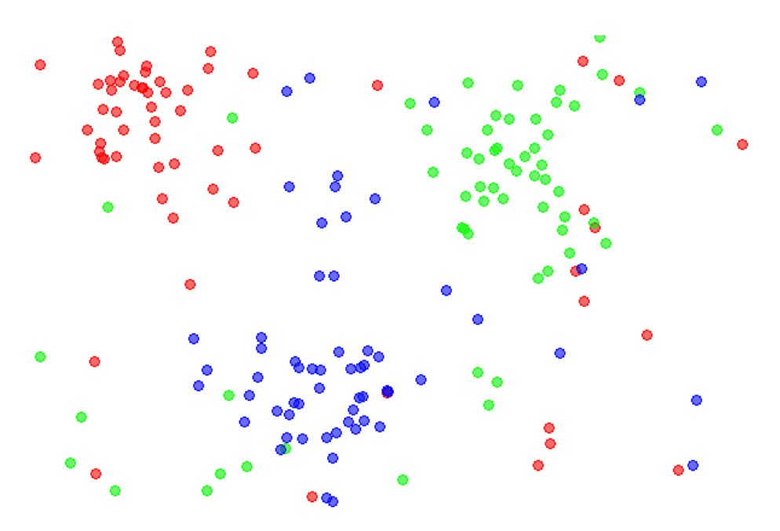
k-Nearest Neighbors (cont’d)
Suppose we have 3 classes of input data
How would we classify an unknown point using kNN?
Notes:
Content:
Not every GenAI idea is worth pursuing immediately. Use a 3-factor model:
🔢 1. ROI (Return on Investment)
Time saved per sprint
Reduction in delivery delays or defects
Value of insight gained
🧩 2. Complexity
Data requirements and integration effort
Workflow disruption and training needs
Tool/vendor dependency
✅ 3. Feasibility
Team maturity and skills
Existing tool compatibility
Governance and AI policy readiness
Use This Matrix:
Quick Wins – High ROI, low complexity (start here)
Strategic Bets – High ROI, high complexity (plan for scale)
Deprioritized – Low ROI, high complexity (low leverage)
Example Exercise:
Score the "automated release note generator":
ROI = High
Complexity = Medium
Feasibility = High
→ Prioritize for pilot

Slide 43
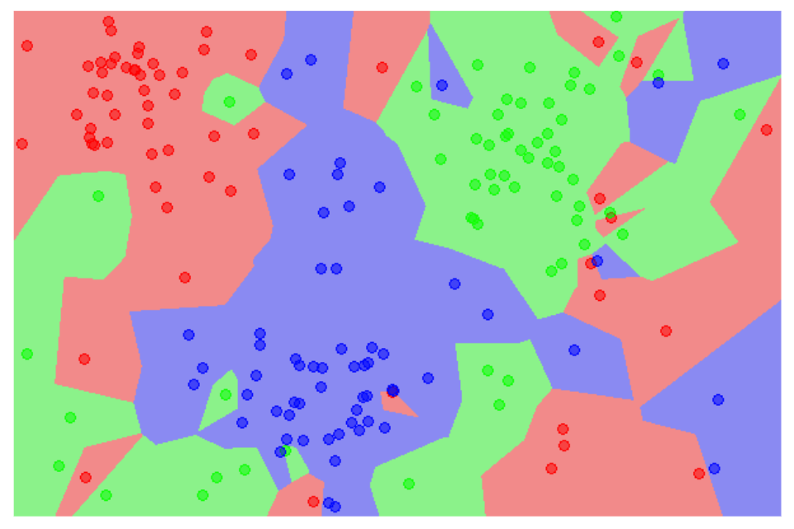
k-Nearest Neighbors (cont’d)
k = 1
Each unknown point is “pulled” towards its nearest neighbor
If nearest neighbor is “weird”, points may be misclassified
Notes:
Content:
Not every GenAI idea is worth pursuing immediately. Use a 3-factor model:
🔢 1. ROI (Return on Investment)
Time saved per sprint
Reduction in delivery delays or defects
Value of insight gained
🧩 2. Complexity
Data requirements and integration effort
Workflow disruption and training needs
Tool/vendor dependency
✅ 3. Feasibility
Team maturity and skills
Existing tool compatibility
Governance and AI policy readiness
Use This Matrix:
Quick Wins – High ROI, low complexity (start here)
Strategic Bets – High ROI, high complexity (plan for scale)
Deprioritized – Low ROI, high complexity (low leverage)
Example Exercise:
Score the "automated release note generator":
ROI = High
Complexity = Medium
Feasibility = High
→ Prioritize for pilot

Slide 44
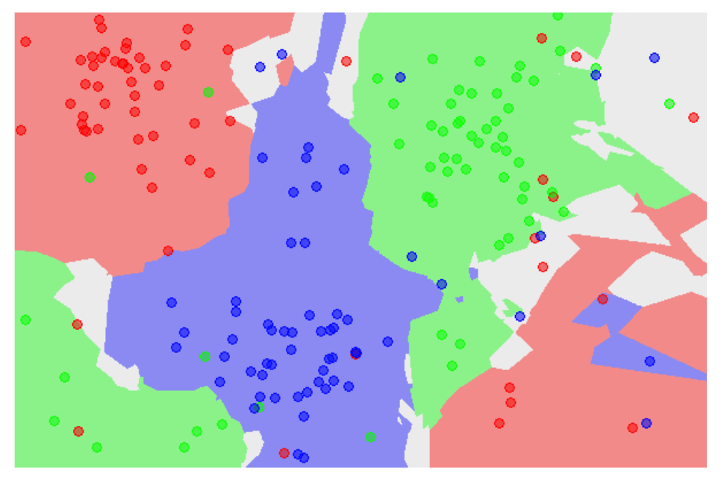
k-Nearest Neighbors (cont’d)
k = 5
What happens as k increases?
What are the white areas?
Notes:
Content:
Not every GenAI idea is worth pursuing immediately. Use a 3-factor model:
🔢 1. ROI (Return on Investment)
Time saved per sprint
Reduction in delivery delays or defects
Value of insight gained
🧩 2. Complexity
Data requirements and integration effort
Workflow disruption and training needs
Tool/vendor dependency
✅ 3. Feasibility
Team maturity and skills
Existing tool compatibility
Governance and AI policy readiness
Use This Matrix:
Quick Wins – High ROI, low complexity (start here)
Strategic Bets – High ROI, high complexity (plan for scale)
Deprioritized – Low ROI, high complexity (low leverage)
Example Exercise:
Score the "automated release note generator":
ROI = High
Complexity = Medium
Feasibility = High
→ Prioritize for pilot

Slide 45
Classification – Logistic Regression & Metrics
Tree-based Learning – Decision Trees
Nearest Neighbors – KNN
Unsupervised Learning – Clustering with K-Means
Intro to Neural Networks
Case Study
AGENDA

Slide 46
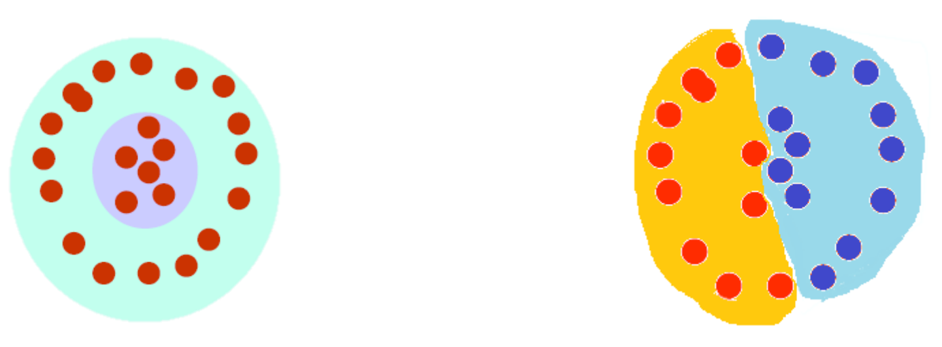
What is clustering?
The organization of unlabeled data into similarity groups called clusters.
A cluster is a collection of data items which are “similar” between them, and “dissimilar” to data items in other clusters.
Notes:
Content:
Not every GenAI idea is worth pursuing immediately. Use a 3-factor model:
🔢 1. ROI (Return on Investment)
Time saved per sprint
Reduction in delivery delays or defects
Value of insight gained
🧩 2. Complexity
Data requirements and integration effort
Workflow disruption and training needs
Tool/vendor dependency
✅ 3. Feasibility
Team maturity and skills
Existing tool compatibility
Governance and AI policy readiness
Use This Matrix:
Quick Wins – High ROI, low complexity (start here)
Strategic Bets – High ROI, high complexity (plan for scale)
Deprioritized – Low ROI, high complexity (low leverage)
Example Exercise:
Score the "automated release note generator":
ROI = High
Complexity = Medium
Feasibility = High
→ Prioritize for pilot

Slide 47
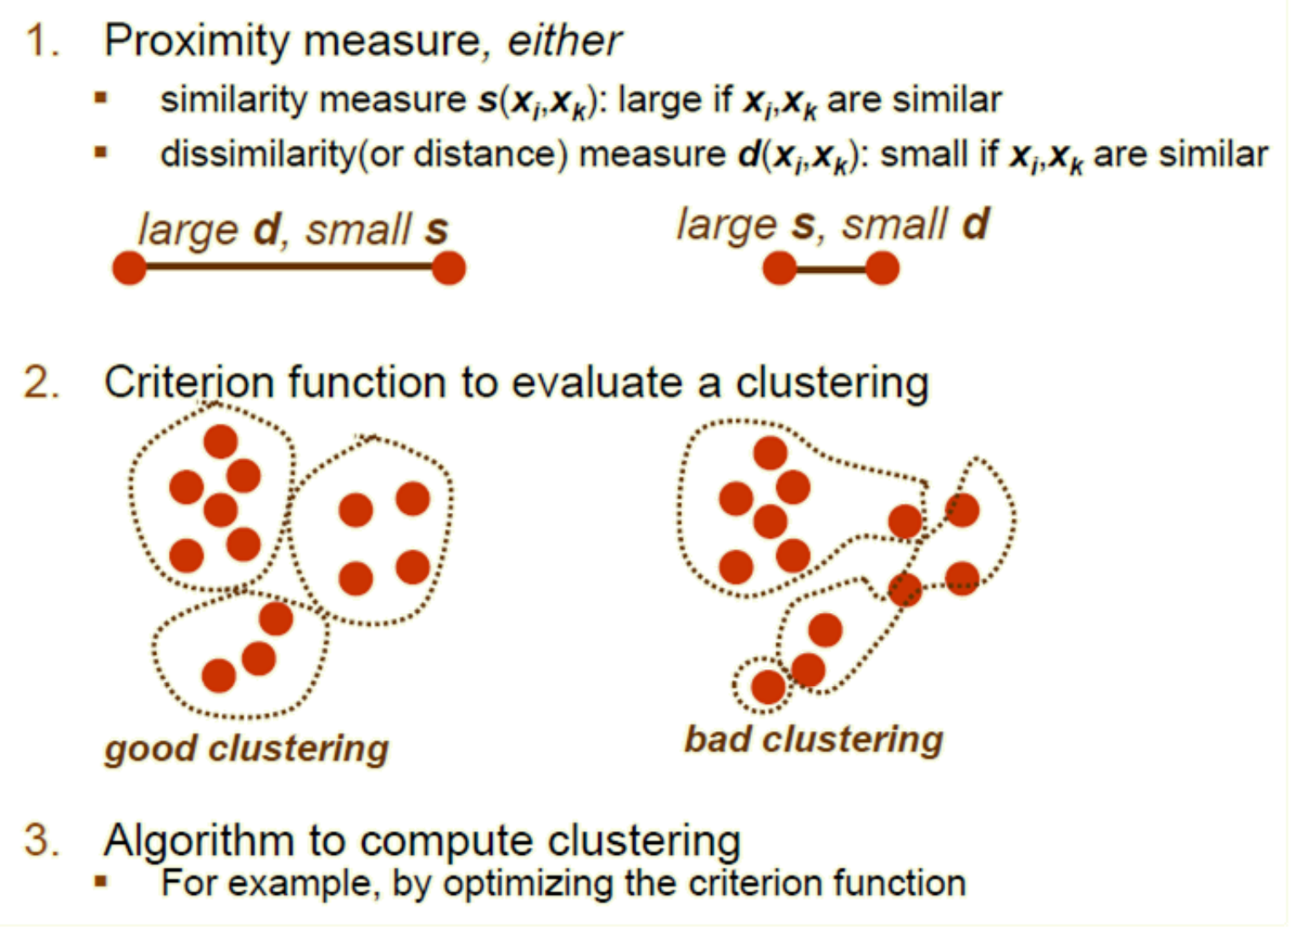
What do we need for clustering?
Notes:
Content:
Not every GenAI idea is worth pursuing immediately. Use a 3-factor model:
🔢 1. ROI (Return on Investment)
Time saved per sprint
Reduction in delivery delays or defects
Value of insight gained
🧩 2. Complexity
Data requirements and integration effort
Workflow disruption and training needs
Tool/vendor dependency
✅ 3. Feasibility
Team maturity and skills
Existing tool compatibility
Governance and AI policy readiness
Use This Matrix:
Quick Wins – High ROI, low complexity (start here)
Strategic Bets – High ROI, high complexity (plan for scale)
Deprioritized – Low ROI, high complexity (low leverage)
Example Exercise:
Score the "automated release note generator":
ROI = High
Complexity = Medium
Feasibility = High
→ Prioritize for pilot

Slide 48
Cluster evaluation (a hard problem)
Intra-cluster cohesion (compactness):
  Cohesion measures how near the data points in a cluster are to the cluster centroid.
  Sum of squared error (SSE) is a commonly used measure.
Inter-cluster separation (isolation):
  Separation means that different cluster centroids should be far away from one another.
In most applications, expert judgments are still the key
Notes:
Content:
Not every GenAI idea is worth pursuing immediately. Use a 3-factor model:
🔢 1. ROI (Return on Investment)
Time saved per sprint
Reduction in delivery delays or defects
Value of insight gained
🧩 2. Complexity
Data requirements and integration effort
Workflow disruption and training needs
Tool/vendor dependency
✅ 3. Feasibility
Team maturity and skills
Existing tool compatibility
Governance and AI policy readiness
Use This Matrix:
Quick Wins – High ROI, low complexity (start here)
Strategic Bets – High ROI, high complexity (plan for scale)
Deprioritized – Low ROI, high complexity (low leverage)
Example Exercise:
Score the "automated release note generator":
ROI = High
Complexity = Medium
Feasibility = High
→ Prioritize for pilot

Slide 49
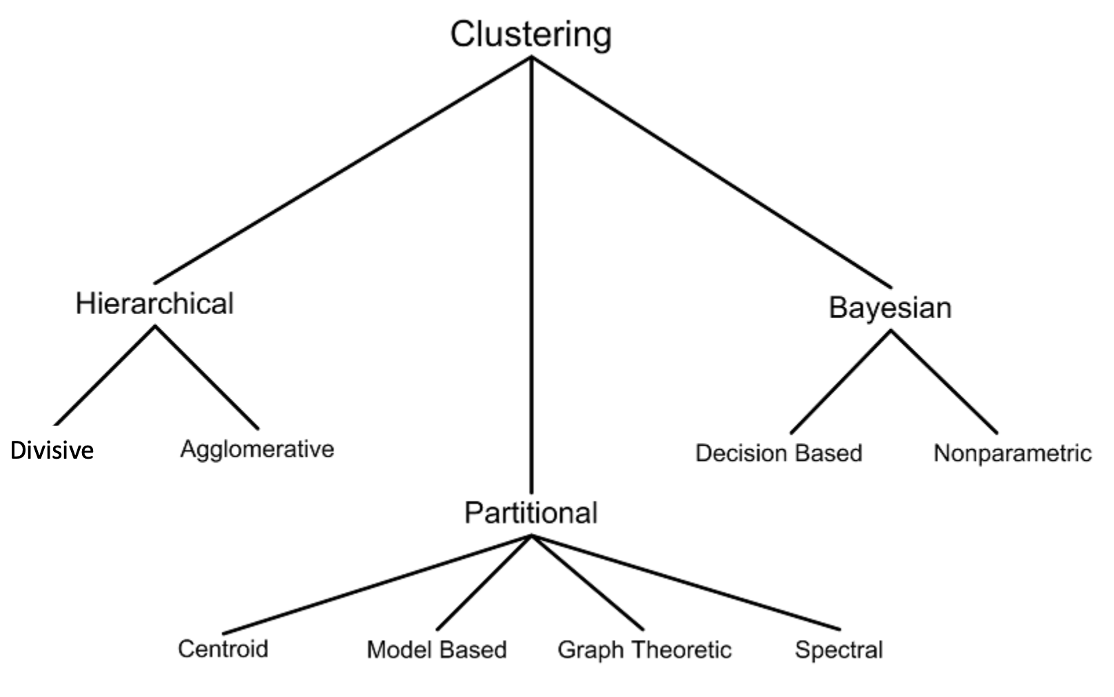
Clustering techniques
Notes:
Content:
Not every GenAI idea is worth pursuing immediately. Use a 3-factor model:
🔢 1. ROI (Return on Investment)
Time saved per sprint
Reduction in delivery delays or defects
Value of insight gained
🧩 2. Complexity
Data requirements and integration effort
Workflow disruption and training needs
Tool/vendor dependency
✅ 3. Feasibility
Team maturity and skills
Existing tool compatibility
Governance and AI policy readiness
Use This Matrix:
Quick Wins – High ROI, low complexity (start here)
Strategic Bets – High ROI, high complexity (plan for scale)
Deprioritized – Low ROI, high complexity (low leverage)
Example Exercise:
Score the "automated release note generator":
ROI = High
Complexity = Medium
Feasibility = High
→ Prioritize for pilot

Slide 50
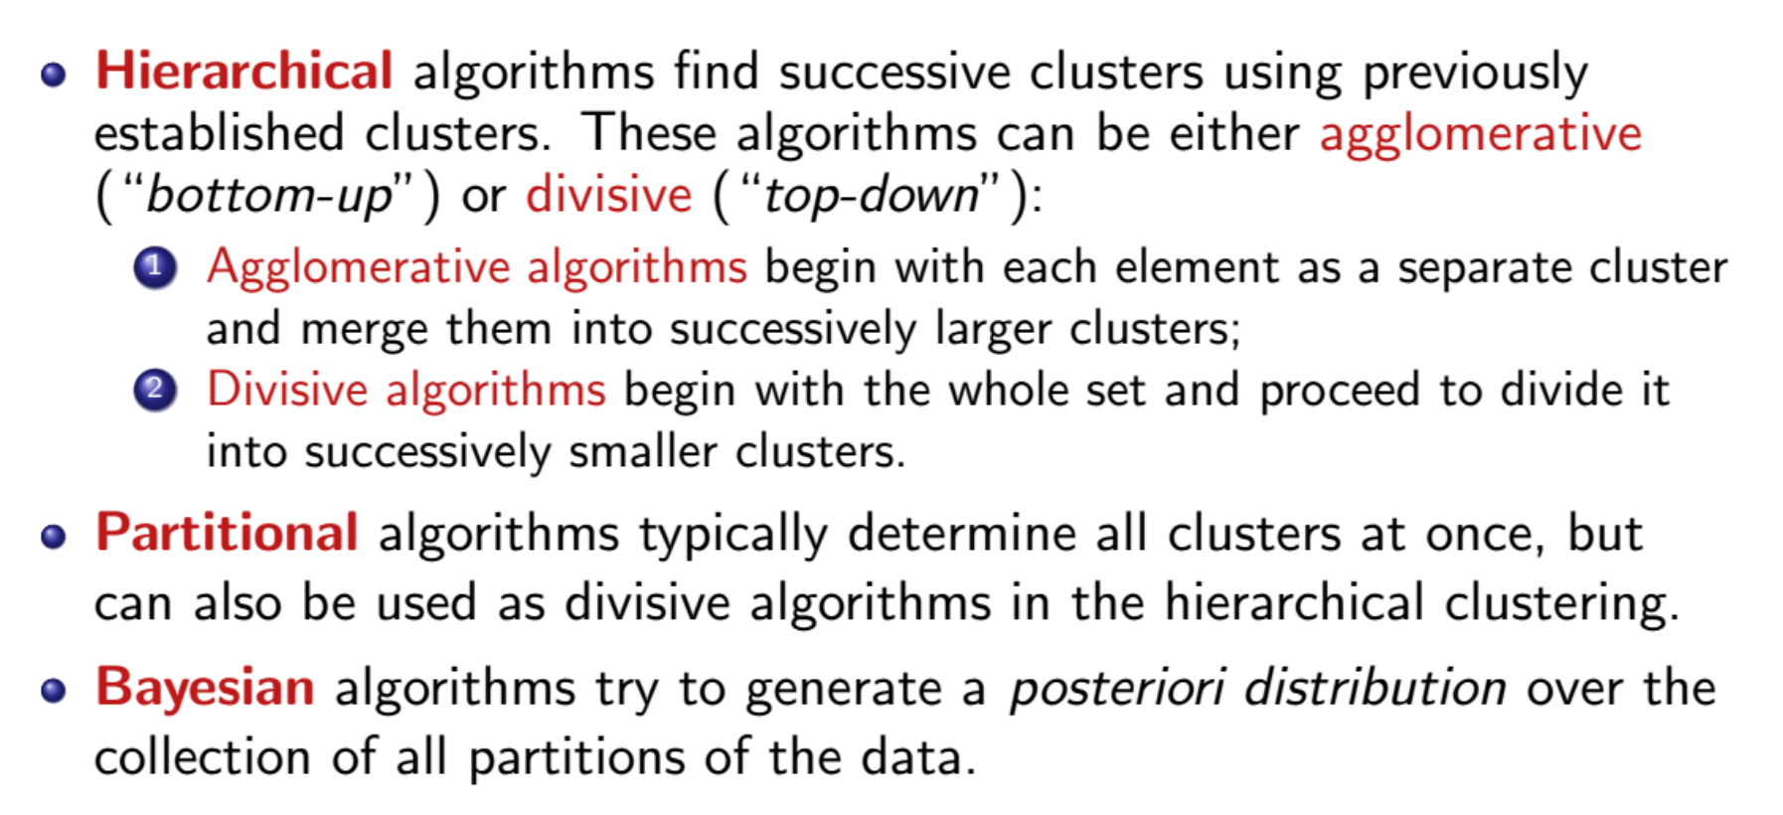
Clustering techniques
Notes:
Content:
Not every GenAI idea is worth pursuing immediately. Use a 3-factor model:
🔢 1. ROI (Return on Investment)
Time saved per sprint
Reduction in delivery delays or defects
Value of insight gained
🧩 2. Complexity
Data requirements and integration effort
Workflow disruption and training needs
Tool/vendor dependency
✅ 3. Feasibility
Team maturity and skills
Existing tool compatibility
Governance and AI policy readiness
Use This Matrix:
Quick Wins – High ROI, low complexity (start here)
Strategic Bets – High ROI, high complexity (plan for scale)
Deprioritized – Low ROI, high complexity (low leverage)
Example Exercise:
Score the "automated release note generator":
ROI = High
Complexity = Medium
Feasibility = High
→ Prioritize for pilot

Slide 51
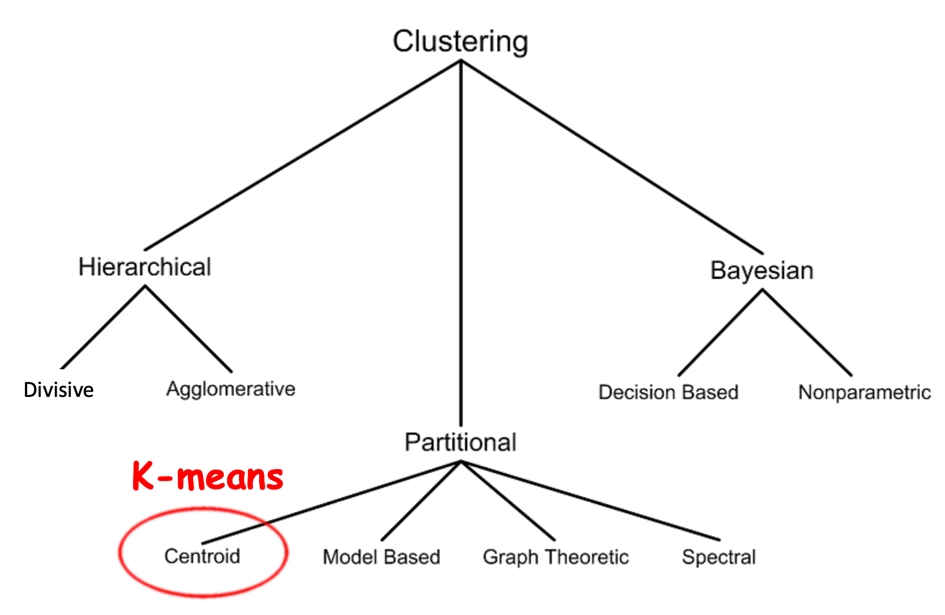
Clustering techniques
Notes:
Content:
Not every GenAI idea is worth pursuing immediately. Use a 3-factor model:
🔢 1. ROI (Return on Investment)
Time saved per sprint
Reduction in delivery delays or defects
Value of insight gained
🧩 2. Complexity
Data requirements and integration effort
Workflow disruption and training needs
Tool/vendor dependency
✅ 3. Feasibility
Team maturity and skills
Existing tool compatibility
Governance and AI policy readiness
Use This Matrix:
Quick Wins – High ROI, low complexity (start here)
Strategic Bets – High ROI, high complexity (plan for scale)
Deprioritized – Low ROI, high complexity (low leverage)
Example Exercise:
Score the "automated release note generator":
ROI = High
Complexity = Medium
Feasibility = High
→ Prioritize for pilot

Slide 52
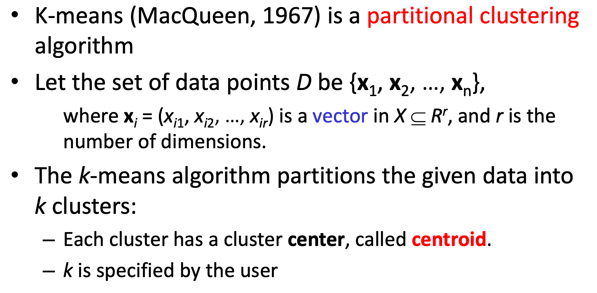
K-means clustering
Notes:
Content:
Not every GenAI idea is worth pursuing immediately. Use a 3-factor model:
🔢 1. ROI (Return on Investment)
Time saved per sprint
Reduction in delivery delays or defects
Value of insight gained
🧩 2. Complexity
Data requirements and integration effort
Workflow disruption and training needs
Tool/vendor dependency
✅ 3. Feasibility
Team maturity and skills
Existing tool compatibility
Governance and AI policy readiness
Use This Matrix:
Quick Wins – High ROI, low complexity (start here)
Strategic Bets – High ROI, high complexity (plan for scale)
Deprioritized – Low ROI, high complexity (low leverage)
Example Exercise:
Score the "automated release note generator":
ROI = High
Complexity = Medium
Feasibility = High
→ Prioritize for pilot

Slide 53
K-means clustering
Given k, the k-means algorithm works as follows:
1. Choose k (random) data points (seeds) to be the initial centroids, cluster centers
2. Assign each data point to the closest centroid
3. Re-compute the centroids using the current cluster memberships
4. If a convergence criterion is not met, repeat steps 2 and 3
Notes:
Content:
Not every GenAI idea is worth pursuing immediately. Use a 3-factor model:
🔢 1. ROI (Return on Investment)
Time saved per sprint
Reduction in delivery delays or defects
Value of insight gained
🧩 2. Complexity
Data requirements and integration effort
Workflow disruption and training needs
Tool/vendor dependency
✅ 3. Feasibility
Team maturity and skills
Existing tool compatibility
Governance and AI policy readiness
Use This Matrix:
Quick Wins – High ROI, low complexity (start here)
Strategic Bets – High ROI, high complexity (plan for scale)
Deprioritized – Low ROI, high complexity (low leverage)
Example Exercise:
Score the "automated release note generator":
ROI = High
Complexity = Medium
Feasibility = High
→ Prioritize for pilot

Slide 54
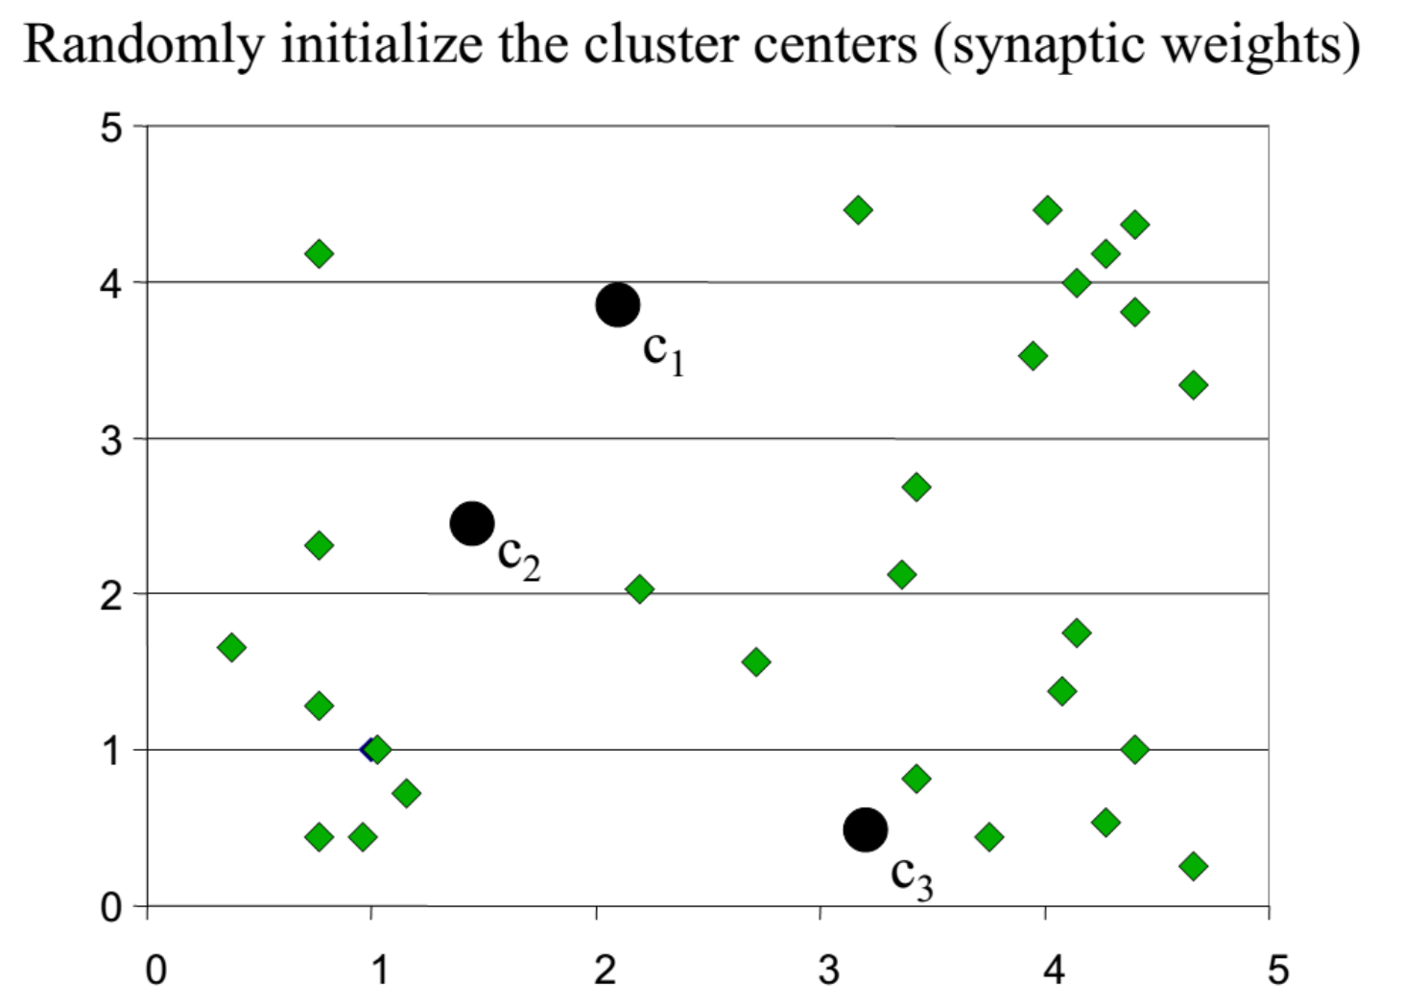
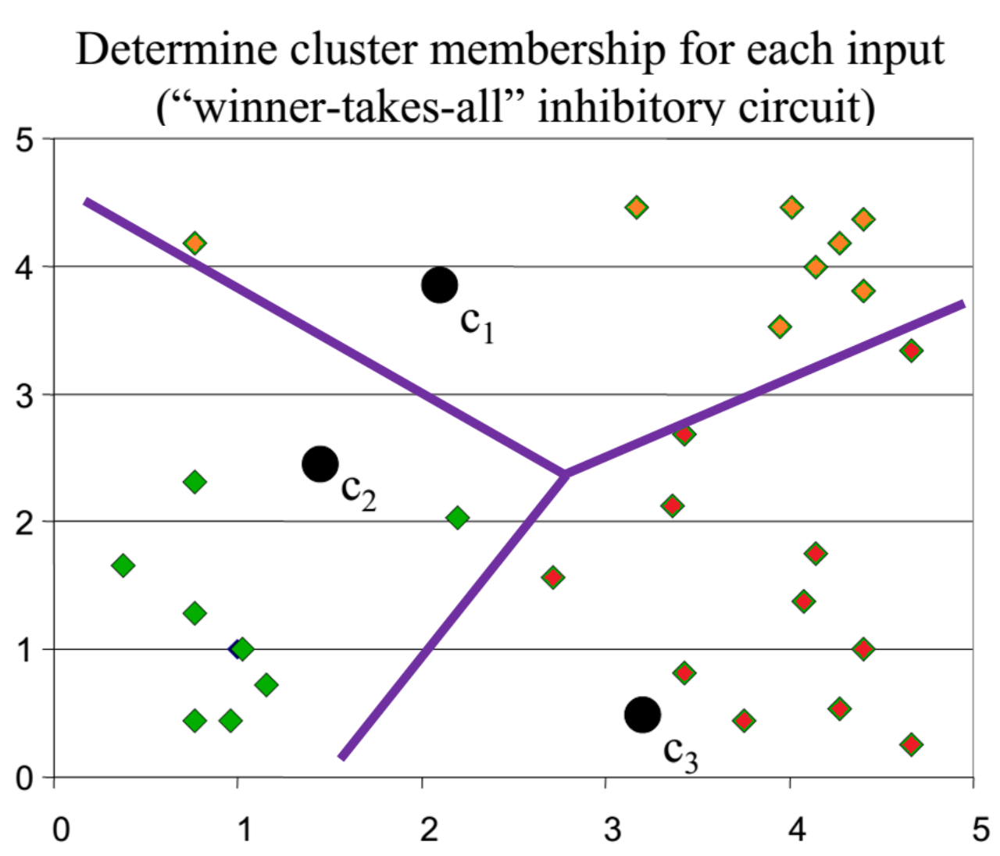
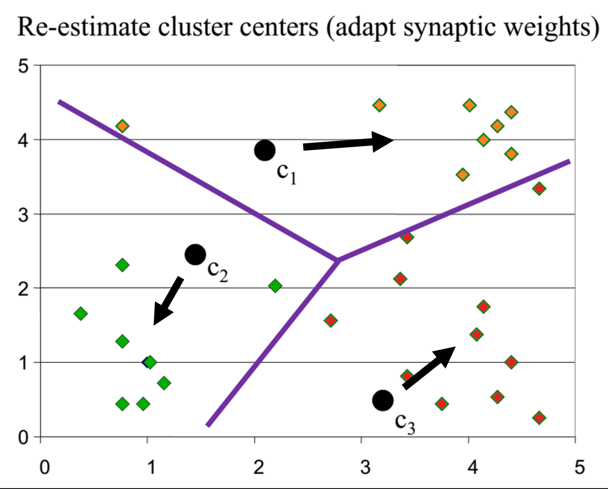
K-means clustering example
1)
2)
3)
Notes:
Content:
Not every GenAI idea is worth pursuing immediately. Use a 3-factor model:
🔢 1. ROI (Return on Investment)
Time saved per sprint
Reduction in delivery delays or defects
Value of insight gained
🧩 2. Complexity
Data requirements and integration effort
Workflow disruption and training needs
Tool/vendor dependency
✅ 3. Feasibility
Team maturity and skills
Existing tool compatibility
Governance and AI policy readiness
Use This Matrix:
Quick Wins – High ROI, low complexity (start here)
Strategic Bets – High ROI, high complexity (plan for scale)
Deprioritized – Low ROI, high complexity (low leverage)
Example Exercise:
Score the "automated release note generator":
ROI = High
Complexity = Medium
Feasibility = High
→ Prioritize for pilot

Slide 55
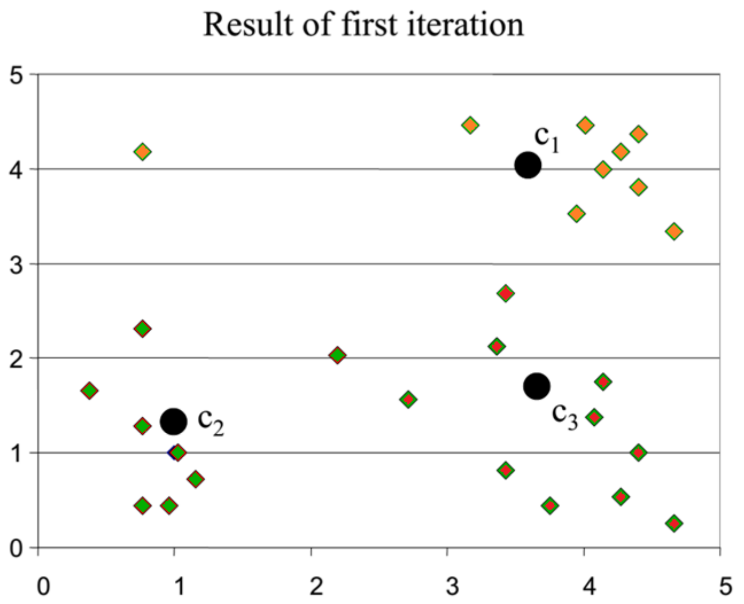
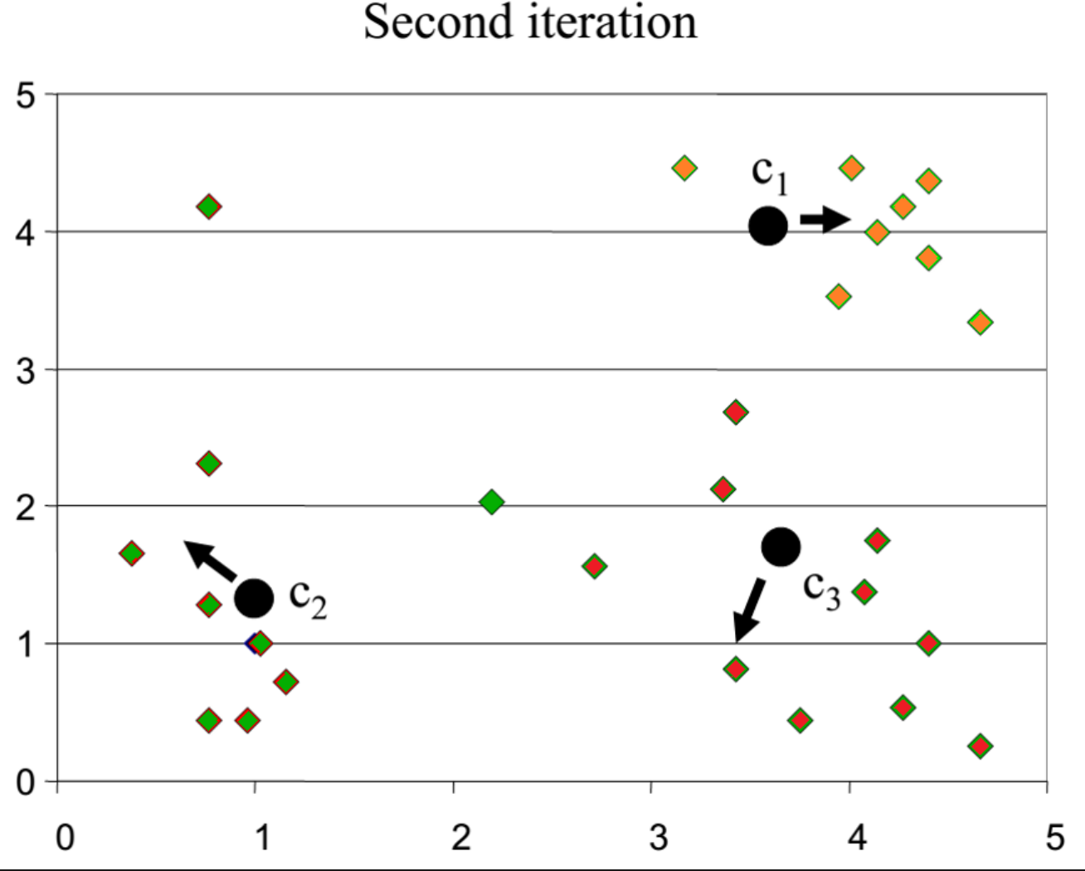
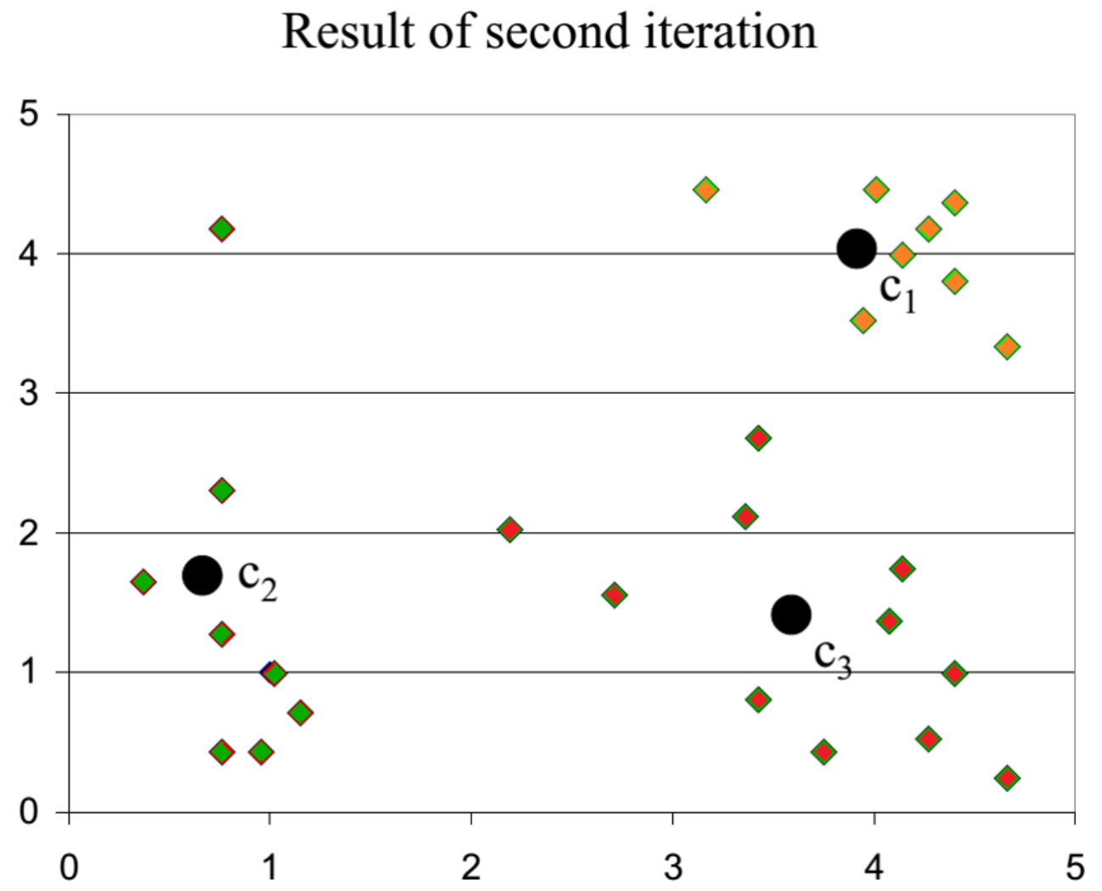
K-means clustering example
4)
5)
6)
Notes:
Content:
Not every GenAI idea is worth pursuing immediately. Use a 3-factor model:
🔢 1. ROI (Return on Investment)
Time saved per sprint
Reduction in delivery delays or defects
Value of insight gained
🧩 2. Complexity
Data requirements and integration effort
Workflow disruption and training needs
Tool/vendor dependency
✅ 3. Feasibility
Team maturity and skills
Existing tool compatibility
Governance and AI policy readiness
Use This Matrix:
Quick Wins – High ROI, low complexity (start here)
Strategic Bets – High ROI, high complexity (plan for scale)
Deprioritized – Low ROI, high complexity (low leverage)
Example Exercise:
Score the "automated release note generator":
ROI = High
Complexity = Medium
Feasibility = High
→ Prioritize for pilot

Slide 56
Why use K-means?
Strengths:
Simple: easy to understand and to implement
Efficient: Time complexity: O(tkn),
  where n is the number of data points,
  k is the number of clusters, and
  t is the number of iterations.
Since both k and t are small. k-means is considered a linear algorithm.
Notes:
Content:
Not every GenAI idea is worth pursuing immediately. Use a 3-factor model:
🔢 1. ROI (Return on Investment)
Time saved per sprint
Reduction in delivery delays or defects
Value of insight gained
🧩 2. Complexity
Data requirements and integration effort
Workflow disruption and training needs
Tool/vendor dependency
✅ 3. Feasibility
Team maturity and skills
Existing tool compatibility
Governance and AI policy readiness
Use This Matrix:
Quick Wins – High ROI, low complexity (start here)
Strategic Bets – High ROI, high complexity (plan for scale)
Deprioritized – Low ROI, high complexity (low leverage)
Example Exercise:
Score the "automated release note generator":
ROI = High
Complexity = Medium
Feasibility = High
→ Prioritize for pilot

Slide 57
Weaknesses of K-means
The algorithm is only applicable if the mean is defined.
  For categorical data, k-mode - the centroid is represented by most frequent values.
The user needs to specify k.
The algorithm is sensitive to outliers
  Outliers are data points that are very far away from other data points.
  Outliers could be errors in the data recording or some special data points with very different values.
Notes:
Content:
Not every GenAI idea is worth pursuing immediately. Use a 3-factor model:
🔢 1. ROI (Return on Investment)
Time saved per sprint
Reduction in delivery delays or defects
Value of insight gained
🧩 2. Complexity
Data requirements and integration effort
Workflow disruption and training needs
Tool/vendor dependency
✅ 3. Feasibility
Team maturity and skills
Existing tool compatibility
Governance and AI policy readiness
Use This Matrix:
Quick Wins – High ROI, low complexity (start here)
Strategic Bets – High ROI, high complexity (plan for scale)
Deprioritized – Low ROI, high complexity (low leverage)
Example Exercise:
Score the "automated release note generator":
ROI = High
Complexity = Medium
Feasibility = High
→ Prioritize for pilot

Slide 58
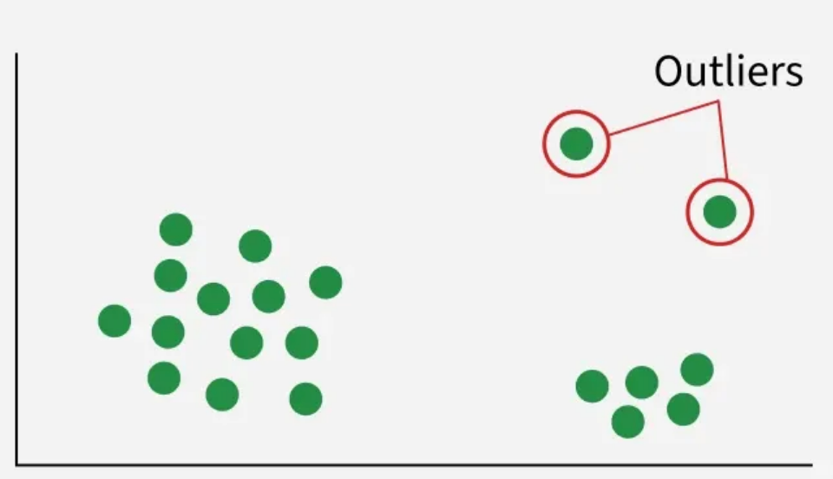
Outliers
In machine learning, outliers are data points that deviate significantly from the general distribution of the dataset. They may occur due to errors in data collection, natural variation or rare events.
Notes:
Content:
Not every GenAI idea is worth pursuing immediately. Use a 3-factor model:
🔢 1. ROI (Return on Investment)
Time saved per sprint
Reduction in delivery delays or defects
Value of insight gained
🧩 2. Complexity
Data requirements and integration effort
Workflow disruption and training needs
Tool/vendor dependency
✅ 3. Feasibility
Team maturity and skills
Existing tool compatibility
Governance and AI policy readiness
Use This Matrix:
Quick Wins – High ROI, low complexity (start here)
Strategic Bets – High ROI, high complexity (plan for scale)
Deprioritized – Low ROI, high complexity (low leverage)
Example Exercise:
Score the "automated release note generator":
ROI = High
Complexity = Medium
Feasibility = High
→ Prioritize for pilot

Slide 59
Types of Outliers
Outliers can be categorized as:
1. Global Outliers (Point Anomalies):
Individual data points that lie far from the rest.
Example: A wine record with alcohol level 20% when most are <15%.
2. Contextual Outliers:
Outliers relative to a specific context or condition.
Example: 30°C might be normal in summer but an outlier in winter.
3.Collective Outliers:
A group of related data points behaving anomalously together.
Example: A sudden spike in residual sugar and acidity in wine samples together.
Notes:
Content:
Not every GenAI idea is worth pursuing immediately. Use a 3-factor model:
🔢 1. ROI (Return on Investment)
Time saved per sprint
Reduction in delivery delays or defects
Value of insight gained
🧩 2. Complexity
Data requirements and integration effort
Workflow disruption and training needs
Tool/vendor dependency
✅ 3. Feasibility
Team maturity and skills
Existing tool compatibility
Governance and AI policy readiness
Use This Matrix:
Quick Wins – High ROI, low complexity (start here)
Strategic Bets – High ROI, high complexity (plan for scale)
Deprioritized – Low ROI, high complexity (low leverage)
Example Exercise:
Score the "automated release note generator":
ROI = High
Complexity = Medium
Feasibility = High
→ Prioritize for pilot

Slide 60
Classification – Logistic Regression & Metrics
Tree-based Learning – Decision Trees
Nearest Neighbors – KNN
Unsupervised Learning – Clustering with K-Means
Intro to Neural Networks
Case Study
AGENDA

Slide 61
Key Components
The networks are built from several key components:
Neurons: The basic units that receive inputs, each neuron is governed by a threshold and an activation function.
Connections: Links between neurons that carry information, regulated by weights and biases.
Weights and Biases: These parameters determine the strength and influence of connections.
Propagation Functions: Mechanisms that help process and transfer data across layers of neurons.
Learning Rule: The method that adjusts weights and biases over time to improve accuracy.
Notes:
Content:
Not every GenAI idea is worth pursuing immediately. Use a 3-factor model:
🔢 1. ROI (Return on Investment)
Time saved per sprint
Reduction in delivery delays or defects
Value of insight gained
🧩 2. Complexity
Data requirements and integration effort
Workflow disruption and training needs
Tool/vendor dependency
✅ 3. Feasibility
Team maturity and skills
Existing tool compatibility
Governance and AI policy readiness
Use This Matrix:
Quick Wins – High ROI, low complexity (start here)
Strategic Bets – High ROI, high complexity (plan for scale)
Deprioritized – Low ROI, high complexity (low leverage)
Example Exercise:
Score the "automated release note generator":
ROI = High
Complexity = Medium
Feasibility = High
→ Prioritize for pilot

Slide 62
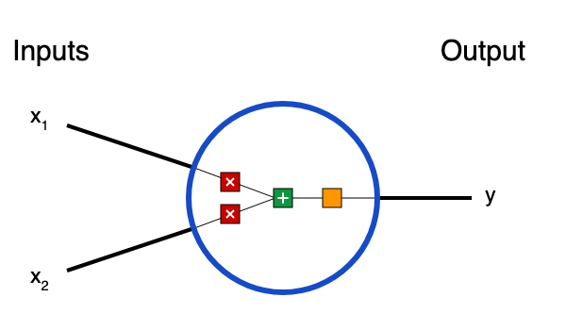
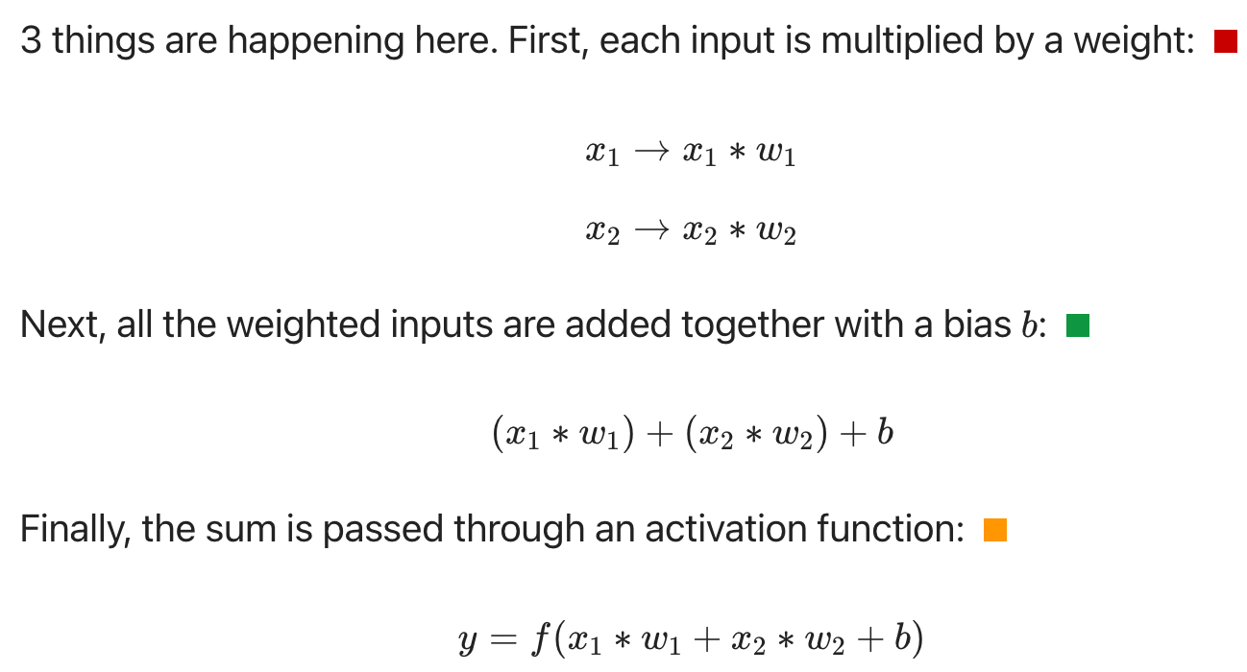
Building Blocks: Neurons
First, we have to talk about neurons, the basic unit of a neural network. A neuron takes inputs, does some math with them, and produces one output. Here’s what a 2-input neuron looks like:
Notes:
Content:
Not every GenAI idea is worth pursuing immediately. Use a 3-factor model:
🔢 1. ROI (Return on Investment)
Time saved per sprint
Reduction in delivery delays or defects
Value of insight gained
🧩 2. Complexity
Data requirements and integration effort
Workflow disruption and training needs
Tool/vendor dependency
✅ 3. Feasibility
Team maturity and skills
Existing tool compatibility
Governance and AI policy readiness
Use This Matrix:
Quick Wins – High ROI, low complexity (start here)
Strategic Bets – High ROI, high complexity (plan for scale)
Deprioritized – Low ROI, high complexity (low leverage)
Example Exercise:
Score the "automated release note generator":
ROI = High
Complexity = Medium
Feasibility = High
→ Prioritize for pilot

Slide 63
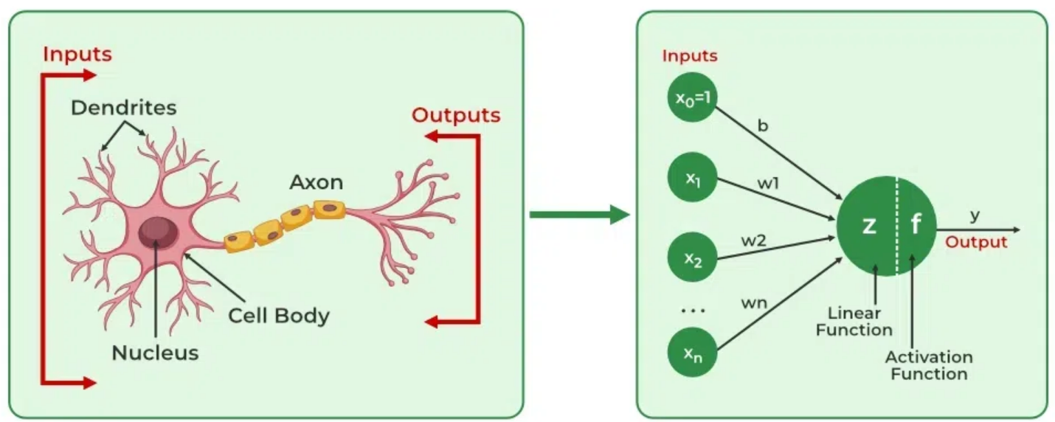
Learning in neural networks
Learning in neural networks follows a structured, three-stage process:
Input Computation: Data is fed into the network.
Output Generation: Based on the current parameters, the network generates an output.
Iterative Refinement: The network refines its output by adjusting weights and biases, gradually improving its performance on diverse tasks.
Source: https://www.geeksforgeeks.org/deep-learning/neural-networks-a-beginners-guide/
Notes:
Content:
Not every GenAI idea is worth pursuing immediately. Use a 3-factor model:
🔢 1. ROI (Return on Investment)
Time saved per sprint
Reduction in delivery delays or defects
Value of insight gained
🧩 2. Complexity
Data requirements and integration effort
Workflow disruption and training needs
Tool/vendor dependency
✅ 3. Feasibility
Team maturity and skills
Existing tool compatibility
Governance and AI policy readiness
Use This Matrix:
Quick Wins – High ROI, low complexity (start here)
Strategic Bets – High ROI, high complexity (plan for scale)
Deprioritized – Low ROI, high complexity (low leverage)
Example Exercise:
Score the "automated release note generator":
ROI = High
Complexity = Medium
Feasibility = High
→ Prioritize for pilot

Slide 64
Importance of Neural Networks
Identify Complex Patterns: Recognize intricate structures and relationships in data; adapt to dynamic and changing environments.
Learn from Data: Handle vast datasets efficiently; improve performance with experience and retraining.
Drive Key Technologies: Power natural language processing (NLP); enable self-driving vehicles; support automated decision-making systems.
Boost Efficiency: Streamline workflows and processes; enhance productivity across industries.
Backbone of AI: Serve as the core driver of artificial intelligence progress; continue shaping the future of technology and innovation.
Source: https://www.geeksforgeeks.org/deep-learning/neural-networks-a-beginners-guide/
Notes:
Content:
Not every GenAI idea is worth pursuing immediately. Use a 3-factor model:
🔢 1. ROI (Return on Investment)
Time saved per sprint
Reduction in delivery delays or defects
Value of insight gained
🧩 2. Complexity
Data requirements and integration effort
Workflow disruption and training needs
Tool/vendor dependency
✅ 3. Feasibility
Team maturity and skills
Existing tool compatibility
Governance and AI policy readiness
Use This Matrix:
Quick Wins – High ROI, low complexity (start here)
Strategic Bets – High ROI, high complexity (plan for scale)
Deprioritized – Low ROI, high complexity (low leverage)
Example Exercise:
Score the "automated release note generator":
ROI = High
Complexity = Medium
Feasibility = High
→ Prioritize for pilot

Slide 65
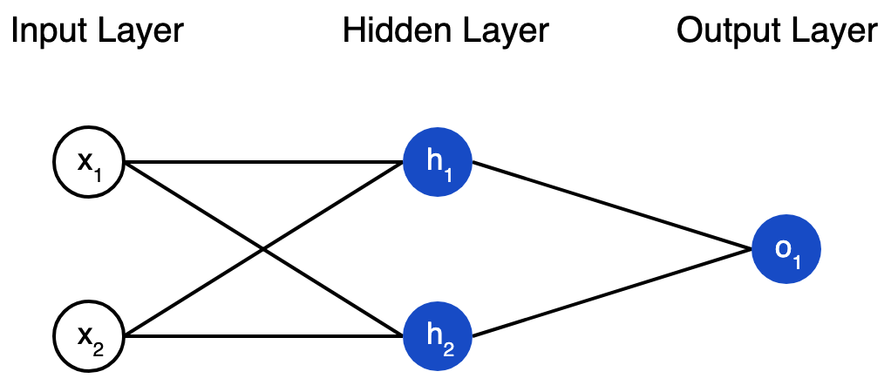
Combining Neurons into a Neural Network
A neural network is nothing more than a bunch of neurons connected together. Here’s what a simple neural network might look like:
Notes:
Content:
Not every GenAI idea is worth pursuing immediately. Use a 3-factor model:
🔢 1. ROI (Return on Investment)
Time saved per sprint
Reduction in delivery delays or defects
Value of insight gained
🧩 2. Complexity
Data requirements and integration effort
Workflow disruption and training needs
Tool/vendor dependency
✅ 3. Feasibility
Team maturity and skills
Existing tool compatibility
Governance and AI policy readiness
Use This Matrix:
Quick Wins – High ROI, low complexity (start here)
Strategic Bets – High ROI, high complexity (plan for scale)
Deprioritized – Low ROI, high complexity (low leverage)
Example Exercise:
Score the "automated release note generator":
ROI = High
Complexity = Medium
Feasibility = High
→ Prioritize for pilot

Slide 66
Layers in Neural Network Architecture
Input Layer: This is where the network receives its input data. Each input neuron in the layer corresponds to a feature in the input data.
Hidden Layers: These layers perform most of the computational heavy lifting. A neural network can have one or multiple hidden layers. Each layer consists of units (neurons) that transform the inputs into something that the output layer can use.
Output Layer: The final layer produces the output of the model. The format of these outputs varies depending on the specific task like classification, regression.
Notes:
Content:
Not every GenAI idea is worth pursuing immediately. Use a 3-factor model:
🔢 1. ROI (Return on Investment)
Time saved per sprint
Reduction in delivery delays or defects
Value of insight gained
🧩 2. Complexity
Data requirements and integration effort
Workflow disruption and training needs
Tool/vendor dependency
✅ 3. Feasibility
Team maturity and skills
Existing tool compatibility
Governance and AI policy readiness
Use This Matrix:
Quick Wins – High ROI, low complexity (start here)
Strategic Bets – High ROI, high complexity (plan for scale)
Deprioritized – Low ROI, high complexity (low leverage)
Example Exercise:
Score the "automated release note generator":
ROI = High
Complexity = Medium
Feasibility = High
→ Prioritize for pilot

Slide 67
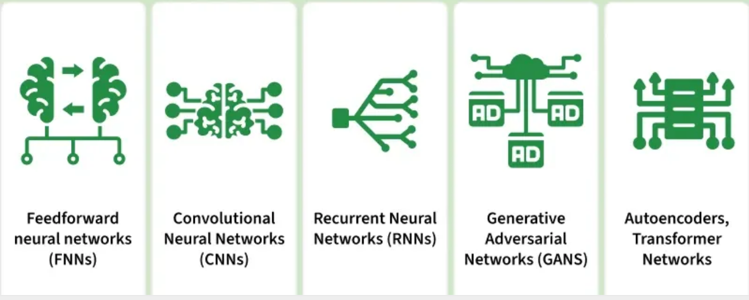
Types of Neural Network
Notes:
Content:
Not every GenAI idea is worth pursuing immediately. Use a 3-factor model:
🔢 1. ROI (Return on Investment)
Time saved per sprint
Reduction in delivery delays or defects
Value of insight gained
🧩 2. Complexity
Data requirements and integration effort
Workflow disruption and training needs
Tool/vendor dependency
✅ 3. Feasibility
Team maturity and skills
Existing tool compatibility
Governance and AI policy readiness
Use This Matrix:
Quick Wins – High ROI, low complexity (start here)
Strategic Bets – High ROI, high complexity (plan for scale)
Deprioritized – Low ROI, high complexity (low leverage)
Example Exercise:
Score the "automated release note generator":
ROI = High
Complexity = Medium
Feasibility = High
→ Prioritize for pilot

Slide 68
How Neurons Process Data in a Neural Network
In a neural network, input data is passed through multiple layers, including one or more hidden layers. Each neuron in these hidden layers performs several operations, transforming the input into a usable output.
1. Input Layer: The input layer contains 3 nodes that indicates the presence of each keyword.
2. Hidden Layer: The input vector is passed through the hidden layer. Each neuron in the hidden layer performs two primary operations: a weighted sum followed by an activation function.
Weights:
Neuron H1: [0.5,−0.2,0.3]
Neuron H2: [0.4,0.1,−0.5]
Input Vector: [1,0,1]
Weighted Sum Calculation
For H1: (1×0.5)+(0×−0.2)+(1×0.3)=0.5+0+0.3=0.8
For H2: (1×0.4)+(0×0.1)+(1×−0.5)=0.4+0−0.5=−0.1
Activation Function
Here we will use ReLu activation function:
H1 Output: ReLU(0.8)= 0.8
H2 Output: ReLu(-0.1) = 0
Notes:
Content:
Not every GenAI idea is worth pursuing immediately. Use a 3-factor model:
🔢 1. ROI (Return on Investment)
Time saved per sprint
Reduction in delivery delays or defects
Value of insight gained
🧩 2. Complexity
Data requirements and integration effort
Workflow disruption and training needs
Tool/vendor dependency
✅ 3. Feasibility
Team maturity and skills
Existing tool compatibility
Governance and AI policy readiness
Use This Matrix:
Quick Wins – High ROI, low complexity (start here)
Strategic Bets – High ROI, high complexity (plan for scale)
Deprioritized – Low ROI, high complexity (low leverage)
Example Exercise:
Score the "automated release note generator":
ROI = High
Complexity = Medium
Feasibility = High
→ Prioritize for pilot

Slide 69
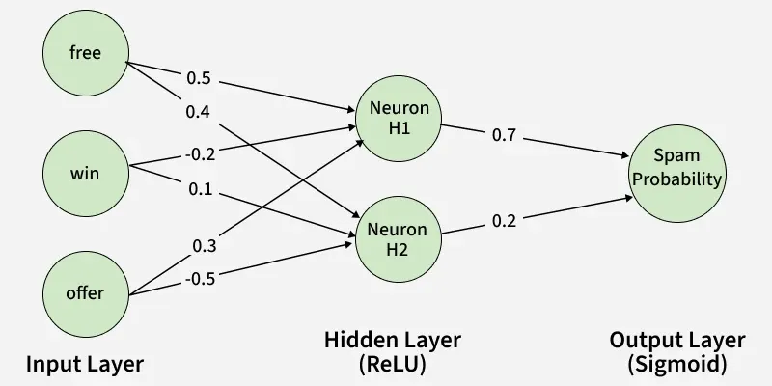
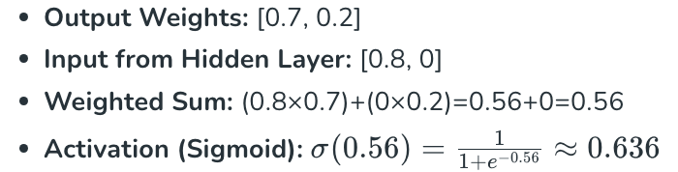
How Neurons Process Data in a Neural Network (continued)
3. Output Layer: The activated values from the hidden neurons are sent to the output neuron where they are again processed using a weighted sum and an activation function.
4. Final Classification:
The output value of approximately 0.636 indicates the probability of the email being spam.
Since this value is greater than 0.5, the neural network classifies the email as spam (1).
Notes:
Content:
Not every GenAI idea is worth pursuing immediately. Use a 3-factor model:
🔢 1. ROI (Return on Investment)
Time saved per sprint
Reduction in delivery delays or defects
Value of insight gained
🧩 2. Complexity
Data requirements and integration effort
Workflow disruption and training needs
Tool/vendor dependency
✅ 3. Feasibility
Team maturity and skills
Existing tool compatibility
Governance and AI policy readiness
Use This Matrix:
Quick Wins – High ROI, low complexity (start here)
Strategic Bets – High ROI, high complexity (plan for scale)
Deprioritized – Low ROI, high complexity (low leverage)
Example Exercise:
Score the "automated release note generator":
ROI = High
Complexity = Medium
Feasibility = High
→ Prioritize for pilot

Slide 70
How Neurons Process Data in a Neural Network (continued)
3. Output Layer: The activated values from the hidden neurons are sent to the output neuron where they are again processed using a weighted sum and an activation function.
4. Final Classification:
The output value of approximately 0.636 indicates the probability of the email being spam.
Since this value is greater than 0.5, the neural network classifies the email as spam (1).
Notes:
Content:
Not every GenAI idea is worth pursuing immediately. Use a 3-factor model:
🔢 1. ROI (Return on Investment)
Time saved per sprint
Reduction in delivery delays or defects
Value of insight gained
🧩 2. Complexity
Data requirements and integration effort
Workflow disruption and training needs
Tool/vendor dependency
✅ 3. Feasibility
Team maturity and skills
Existing tool compatibility
Governance and AI policy readiness
Use This Matrix:
Quick Wins – High ROI, low complexity (start here)
Strategic Bets – High ROI, high complexity (plan for scale)
Deprioritized – Low ROI, high complexity (low leverage)
Example Exercise:
Score the "automated release note generator":
ROI = High
Complexity = Medium
Feasibility = High
→ Prioritize for pilot

Slide 71
Classification – Logistic Regression & Metrics
Tree-based Learning – Decision Trees
Nearest Neighbors – KNN
Unsupervised Learning – Clustering with K-Means
Intro to Neural Networks
Case Study
AGENDA

Slide 72
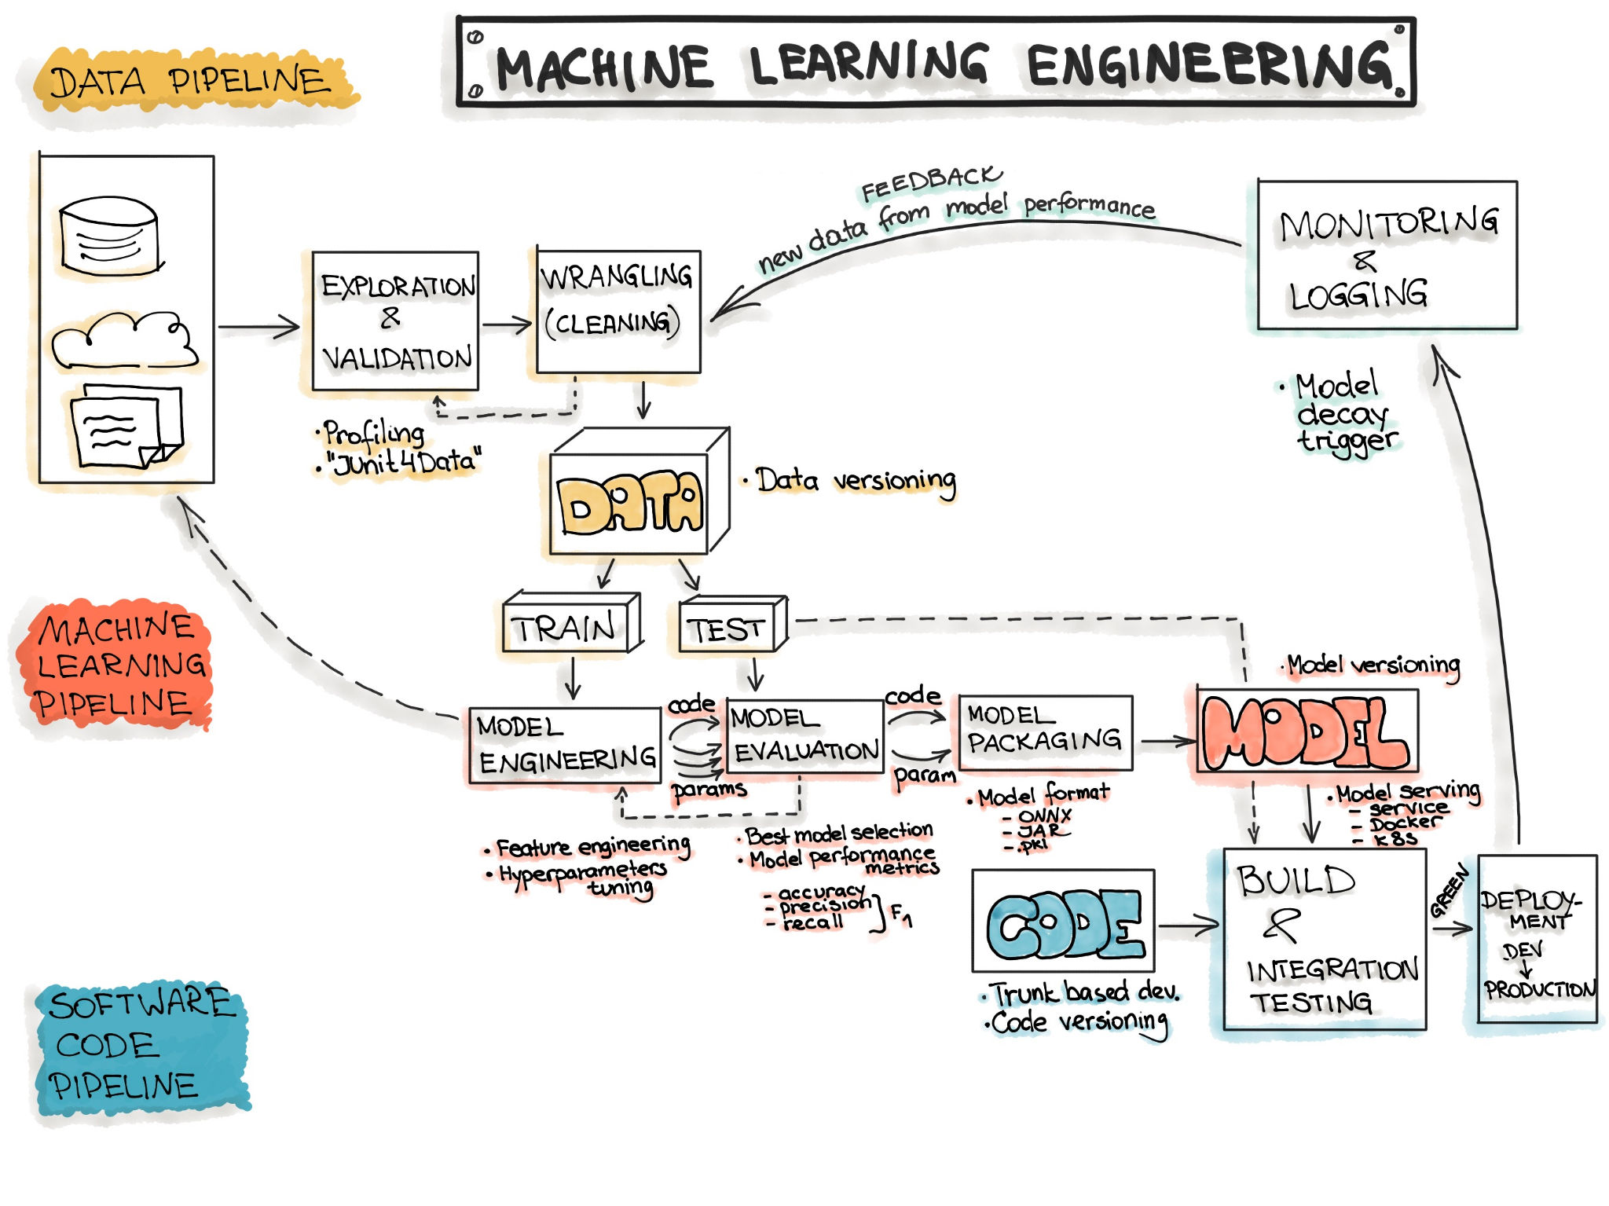
Machine Learning Flow
The typical machine learning workflow consists of three main phases:
Data Engineering: data acquisition & data preparation,
ML Model Engineering: ML model training & serving, and
Code Engineering :integrating ML model into the final product.
Notes:
Content:
Not every GenAI idea is worth pursuing immediately. Use a 3-factor model:
🔢 1. ROI (Return on Investment)
Time saved per sprint
Reduction in delivery delays or defects
Value of insight gained
🧩 2. Complexity
Data requirements and integration effort
Workflow disruption and training needs
Tool/vendor dependency
✅ 3. Feasibility
Team maturity and skills
Existing tool compatibility
Governance and AI policy readiness
Use This Matrix:
Quick Wins – High ROI, low complexity (start here)
Strategic Bets – High ROI, high complexity (plan for scale)
Deprioritized – Low ROI, high complexity (low leverage)
Example Exercise:
Score the "automated release note generator":
ROI = High
Complexity = Medium
Feasibility = High
→ Prioritize for pilot

Slide 73
Data Engineering
Data Engineering is the first step in the data science workflow, focused on collecting, preparing, and organizing data for analysis. Since data usually comes from multiple sources and formats, it must be cleaned and transformed into usable datasets.
This stage is often the most time-consuming and resource-intensive, but it is critical because poor data quality leads to incorrect insights and weak models.
Key Steps
Data Ingestion: Collect data from sources such as databases, files, or distributed systems (e.g., Spark, CSV).
Exploration & Validation: Profile data to understand structure, detect errors, and generate metadata (min, max, averages).
Data Wrangling: Clean and transform data (handle missing values, fix formats).
Data Labeling: Assign categories or labels to data for supervised learning.
Data Splitting: Divide data into training, validation, and test datasets.
Notes:
Content:
Not every GenAI idea is worth pursuing immediately. Use a 3-factor model:
🔢 1. ROI (Return on Investment)
Time saved per sprint
Reduction in delivery delays or defects
Value of insight gained
🧩 2. Complexity
Data requirements and integration effort
Workflow disruption and training needs
Tool/vendor dependency
✅ 3. Feasibility
Team maturity and skills
Existing tool compatibility
Governance and AI policy readiness
Use This Matrix:
Quick Wins – High ROI, low complexity (start here)
Strategic Bets – High ROI, high complexity (plan for scale)
Deprioritized – Low ROI, high complexity (low leverage)
Example Exercise:
Score the "automated release note generator":
ROI = High
Complexity = Medium
Feasibility = High
→ Prioritize for pilot

Slide 74
Model Engineering
Model Engineering focuses on developing and validating machine learning models using prepared data.
Key Steps
Model Training: Apply ML algorithms to training data, including feature engineering and hyperparameter tuning.
Model Evaluation: Measure performance to ensure the model meets defined objectives.
Model Testing: Perform final validation using a hold-out test dataset.
Model Packaging: Export the model in standardized formats (e.g., ONNX, PMML, PFA) so it can be integrated into applications.
Notes:
Content:
Not every GenAI idea is worth pursuing immediately. Use a 3-factor model:
🔢 1. ROI (Return on Investment)
Time saved per sprint
Reduction in delivery delays or defects
Value of insight gained
🧩 2. Complexity
Data requirements and integration effort
Workflow disruption and training needs
Tool/vendor dependency
✅ 3. Feasibility
Team maturity and skills
Existing tool compatibility
Governance and AI policy readiness
Use This Matrix:
Quick Wins – High ROI, low complexity (start here)
Strategic Bets – High ROI, high complexity (plan for scale)
Deprioritized – Low ROI, high complexity (low leverage)
Example Exercise:
Score the "automated release note generator":
ROI = High
Complexity = Medium
Feasibility = High
→ Prioritize for pilot

Slide 75
Model Deployment (Using the Model in Real Applications)
After training, the model must be integrated into real-world systems where it can generate predictions.
Key Steps
Model Serving: Deploy the model in a production environment (e.g., APIs, applications).
Performance Monitoring: Track model performance on new data to detect issues like prediction drift or reduced accuracy.
Model Retraining: Use monitoring signals to trigger updates or retraining when performance declines.
Notes:
Content:
Not every GenAI idea is worth pursuing immediately. Use a 3-factor model:
🔢 1. ROI (Return on Investment)
Time saved per sprint
Reduction in delivery delays or defects
Value of insight gained
🧩 2. Complexity
Data requirements and integration effort
Workflow disruption and training needs
Tool/vendor dependency
✅ 3. Feasibility
Team maturity and skills
Existing tool compatibility
Governance and AI policy readiness
Use This Matrix:
Quick Wins – High ROI, low complexity (start here)
Strategic Bets – High ROI, high complexity (plan for scale)
Deprioritized – Low ROI, high complexity (low leverage)
Example Exercise:
Score the "automated release note generator":
ROI = High
Complexity = Medium
Feasibility = High
→ Prioritize for pilot

Slide 76
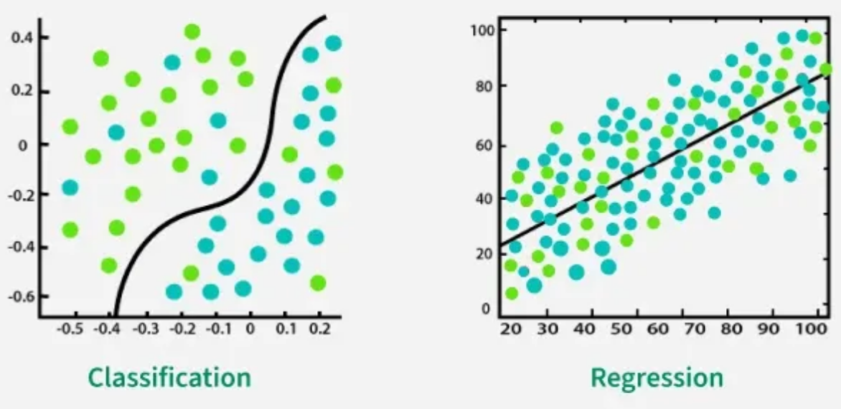
Choosing The Right Model Type
To understand how machine learning models make predictions, it’s important to know the difference between Classification and Regression. Both are supervised learning techniques, but they solve different types of problems depending on the nature of the target variable.
Classification predicts categories or labels like spam/not spam, disease/no disease, etc.
Regression predicts continuous values like price, temperature, sales, etc
Notes:
Content:
Not every GenAI idea is worth pursuing immediately. Use a 3-factor model:
🔢 1. ROI (Return on Investment)
Time saved per sprint
Reduction in delivery delays or defects
Value of insight gained
🧩 2. Complexity
Data requirements and integration effort
Workflow disruption and training needs
Tool/vendor dependency
✅ 3. Feasibility
Team maturity and skills
Existing tool compatibility
Governance and AI policy readiness
Use This Matrix:
Quick Wins – High ROI, low complexity (start here)
Strategic Bets – High ROI, high complexity (plan for scale)
Deprioritized – Low ROI, high complexity (low leverage)
Example Exercise:
Score the "automated release note generator":
ROI = High
Complexity = Medium
Feasibility = High
→ Prioritize for pilot

Slide 77
Regression VS Classification
Features | Regression | Classification
Output Type | Predicts a continuous numeric value | Predicts a categorical label
Goal | Fitting the best-fit line or curve | Drawing a decision boundary between classes
Error Measure | Uses metrics like MSE, MAE, RMSE | Uses metrics like Accuracy, Precision, Recall, F1 Score
Use Cases | Forecasting, price prediction, risk estimation | Image recognition, sentiment analysis, fraud detection
Handling Outliers | Highly sensitive | Less sensitive
Notes:
Content:
Not every GenAI idea is worth pursuing immediately. Use a 3-factor model:
🔢 1. ROI (Return on Investment)
Time saved per sprint
Reduction in delivery delays or defects
Value of insight gained
🧩 2. Complexity
Data requirements and integration effort
Workflow disruption and training needs
Tool/vendor dependency
✅ 3. Feasibility
Team maturity and skills
Existing tool compatibility
Governance and AI policy readiness
Use This Matrix:
Quick Wins – High ROI, low complexity (start here)
Strategic Bets – High ROI, high complexity (plan for scale)
Deprioritized – Low ROI, high complexity (low leverage)
Example Exercise:
Score the "automated release note generator":
ROI = High
Complexity = Medium
Feasibility = High
→ Prioritize for pilot

Slide 78
Choosing The Right Model Type
To understand how machine learning models make predictions, it’s important to know the difference between Classification and Regression. Both are supervised learning techniques, but they solve different types of problems depending on the nature of the target variable.
Classification predicts categories or labels like spam/not spam, disease/no disease, etc.
Regression predicts continuous values like price, temperature, sales, etc
Notes:
Content:
Not every GenAI idea is worth pursuing immediately. Use a 3-factor model:
🔢 1. ROI (Return on Investment)
Time saved per sprint
Reduction in delivery delays or defects
Value of insight gained
🧩 2. Complexity
Data requirements and integration effort
Workflow disruption and training needs
Tool/vendor dependency
✅ 3. Feasibility
Team maturity and skills
Existing tool compatibility
Governance and AI policy readiness
Use This Matrix:
Quick Wins – High ROI, low complexity (start here)
Strategic Bets – High ROI, high complexity (plan for scale)
Deprioritized – Low ROI, high complexity (low leverage)
Example Exercise:
Score the "automated release note generator":
ROI = High
Complexity = Medium
Feasibility = High
→ Prioritize for pilot

Slide 79
Determine the Best Model for Your Use Case
Processing Before Train-Test Split: Data preprocessing should be done after splitting the dataset. If done before, the preprocessing model may learn patterns from the test data, causing data leakage and overly optimistic results.
Duplicate Data: Real-world datasets may contain identical or near-identical entries (e.g., repeated spam messages). If duplicates appear in both training and test sets, the model may simply memorize them, leading to unrealistic performance.
Temporal Data Issues: With time-based data, training on future data and testing on past data gives the model information it wouldn’t have in real scenarios. To avoid this, ensure training data comes earlier in time than testing data.
Notes:
Content:
Not every GenAI idea is worth pursuing immediately. Use a 3-factor model:
🔢 1. ROI (Return on Investment)
Time saved per sprint
Reduction in delivery delays or defects
Value of insight gained
🧩 2. Complexity
Data requirements and integration effort
Workflow disruption and training needs
Tool/vendor dependency
✅ 3. Feasibility
Team maturity and skills
Existing tool compatibility
Governance and AI policy readiness
Use This Matrix:
Quick Wins – High ROI, low complexity (start here)
Strategic Bets – High ROI, high complexity (plan for scale)
Deprioritized – Low ROI, high complexity (low leverage)
Example Exercise:
Score the "automated release note generator":
ROI = High
Complexity = Medium
Feasibility = High
→ Prioritize for pilot

Slide 80
Prevent Test Data Leakage
We can unpack industry folklore such as the No Free Lunch (NFL) theorem to help us reevaluate any assumptions about which ML model to use. The NFL theorem suggests that no ML approach is better than any other when applied over every possible problem.
Even if no amount of research can exactly prescribe the best ML model for a specific use case, it can still provide some explicit no-gos including:
Using a deep neural network in instances where data is limited.
Using models that expect categorical features to a dataset which consists of numeric features.
Using a model that assumes no dependencies between variables and time series data.
Notes:
Content:
Not every GenAI idea is worth pursuing immediately. Use a 3-factor model:
🔢 1. ROI (Return on Investment)
Time saved per sprint
Reduction in delivery delays or defects
Value of insight gained
🧩 2. Complexity
Data requirements and integration effort
Workflow disruption and training needs
Tool/vendor dependency
✅ 3. Feasibility
Team maturity and skills
Existing tool compatibility
Governance and AI policy readiness
Use This Matrix:
Quick Wins – High ROI, low complexity (start here)
Strategic Bets – High ROI, high complexity (plan for scale)
Deprioritized – Low ROI, high complexity (low leverage)
Example Exercise:
Score the "automated release note generator":
ROI = High
Complexity = Medium
Feasibility = High
→ Prioritize for pilot

Slide 81

Hyperparameter Optimization
To create efficient ML algorithms, you need to optimize any hyperparameters to get the best result for your use case. Examples of hyperparameters include number of trees in a random forest or the architecture of a neural network.
Notes:
Content:
Not every GenAI idea is worth pursuing immediately. Use a 3-factor model:
🔢 1. ROI (Return on Investment)
Time saved per sprint
Reduction in delivery delays or defects
Value of insight gained
🧩 2. Complexity
Data requirements and integration effort
Workflow disruption and training needs
Tool/vendor dependency
✅ 3. Feasibility
Team maturity and skills
Existing tool compatibility
Governance and AI policy readiness
Use This Matrix:
Quick Wins – High ROI, low complexity (start here)
Strategic Bets – High ROI, high complexity (plan for scale)
Deprioritized – Low ROI, high complexity (low leverage)
Example Exercise:
Score the "automated release note generator":
ROI = High
Complexity = Medium
Feasibility = High
→ Prioritize for pilot

Slide 82
Hyperparameter Optimization (continued)
Some of the most well-known optimization approaches include:
Grid search: Also known as a parameter sweep, grid search is an exhaustive search through a manually specified subset of the hyperparameter space of a learning algorithm.
Random Search: Randomly samples hyperparameter combinations instead of testing all possibilities like grid search. Faster and often finds good solutions efficiently.
Bayesian Optimization: Builds a probabilistic model linking hyperparameters to performance and iteratively tests promising configurations to find the optimum.
Evolutionary Optimization: Uses evolutionary algorithms (selection, crossover, mutation) to evolve better hyperparameter sets over generations.
Population-Based Training: Runs multiple models with different hyperparameters simultaneously and replaces poorly performing models with improved versions of better ones.
Notes:
Content:
Not every GenAI idea is worth pursuing immediately. Use a 3-factor model:
🔢 1. ROI (Return on Investment)
Time saved per sprint
Reduction in delivery delays or defects
Value of insight gained
🧩 2. Complexity
Data requirements and integration effort
Workflow disruption and training needs
Tool/vendor dependency
✅ 3. Feasibility
Team maturity and skills
Existing tool compatibility
Governance and AI policy readiness
Use This Matrix:
Quick Wins – High ROI, low complexity (start here)
Strategic Bets – High ROI, high complexity (plan for scale)
Deprioritized – Low ROI, high complexity (low leverage)
Example Exercise:
Score the "automated release note generator":
ROI = High
Complexity = Medium
Feasibility = High
→ Prioritize for pilot

Slide 83
Real-World Use Cases
Artificial Intelligence and Machine Learning are widely used in everyday digital services.
Common areas include:
Personalized recommendations
Fraud detection
Traffic prediction
Autonomous driving
Healthcare diagnostics
Email spam filtering
These systems analyze large volumes of data to predict behavior, classify information, and optimize decisions.
Notes:
Content:
Not every GenAI idea is worth pursuing immediately. Use a 3-factor model:
🔢 1. ROI (Return on Investment)
Time saved per sprint
Reduction in delivery delays or defects
Value of insight gained
🧩 2. Complexity
Data requirements and integration effort
Workflow disruption and training needs
Tool/vendor dependency
✅ 3. Feasibility
Team maturity and skills
Existing tool compatibility
Governance and AI policy readiness
Use This Matrix:
Quick Wins – High ROI, low complexity (start here)
Strategic Bets – High ROI, high complexity (plan for scale)
Deprioritized – Low ROI, high complexity (low leverage)
Example Exercise:
Score the "automated release note generator":
ROI = High
Complexity = Medium
Feasibility = High
→ Prioritize for pilot

Slide 84

Case Study: Netflix Recommendation System
Company: Netflix
Use Case: Personalized movie and TV show recommendations.
How AI/ML is used:
Analyzes watch history
Uses user ratings and preferences
Compares viewing patterns across users
Impact:
Over 80% of content watched comes from recommendations
Improves user engagement and retention
Notes:
Content:
Not every GenAI idea is worth pursuing immediately. Use a 3-factor model:
🔢 1. ROI (Return on Investment)
Time saved per sprint
Reduction in delivery delays or defects
Value of insight gained
🧩 2. Complexity
Data requirements and integration effort
Workflow disruption and training needs
Tool/vendor dependency
✅ 3. Feasibility
Team maturity and skills
Existing tool compatibility
Governance and AI policy readiness
Use This Matrix:
Quick Wins – High ROI, low complexity (start here)
Strategic Bets – High ROI, high complexity (plan for scale)
Deprioritized – Low ROI, high complexity (low leverage)
Example Exercise:
Score the "automated release note generator":
ROI = High
Complexity = Medium
Feasibility = High
→ Prioritize for pilot

Slide 85

Case Study: Uber Demand Prediction
Company: Uber
Use Case: Predicting ride demand and optimizing driver allocation.
How AI/ML is used:
Analyzes historical ride data
Uses time, location, and weather patterns
Predicts demand across city zones
Impact:
Reduces passenger wait time
Improves driver utilization
Notes:
Content:
Not every GenAI idea is worth pursuing immediately. Use a 3-factor model:
🔢 1. ROI (Return on Investment)
Time saved per sprint
Reduction in delivery delays or defects
Value of insight gained
🧩 2. Complexity
Data requirements and integration effort
Workflow disruption and training needs
Tool/vendor dependency
✅ 3. Feasibility
Team maturity and skills
Existing tool compatibility
Governance and AI policy readiness
Use This Matrix:
Quick Wins – High ROI, low complexity (start here)
Strategic Bets – High ROI, high complexity (plan for scale)
Deprioritized – Low ROI, high complexity (low leverage)
Example Exercise:
Score the "automated release note generator":
ROI = High
Complexity = Medium
Feasibility = High
→ Prioritize for pilot

Slide 86

Case Study: Gmail Spam Detection
Product: Gmail
Company: Google
Use Case: Automatic spam email filtering.
How AI/ML is used:
Text classification models
Pattern recognition in email content
Sender reputation analysis
Impact:
Blocks billions of spam emails daily
Protects users from phishing and scams
Notes:
Content:
Not every GenAI idea is worth pursuing immediately. Use a 3-factor model:
🔢 1. ROI (Return on Investment)
Time saved per sprint
Reduction in delivery delays or defects
Value of insight gained
🧩 2. Complexity
Data requirements and integration effort
Workflow disruption and training needs
Tool/vendor dependency
✅ 3. Feasibility
Team maturity and skills
Existing tool compatibility
Governance and AI policy readiness
Use This Matrix:
Quick Wins – High ROI, low complexity (start here)
Strategic Bets – High ROI, high complexity (plan for scale)
Deprioritized – Low ROI, high complexity (low leverage)
Example Exercise:
Score the "automated release note generator":
ROI = High
Complexity = Medium
Feasibility = High
→ Prioritize for pilot

Slide 87

Key Takeaways
AI/ML enables systems to:
Predict user behavior
Personalized experience
Detect anomalies and fraud
Optimize operations
Industries using AI today:
Entertainment
E-commerce
Transportation
Finance
Healthcare
Notes:
Content:
Not every GenAI idea is worth pursuing immediately. Use a 3-factor model:
🔢 1. ROI (Return on Investment)
Time saved per sprint
Reduction in delivery delays or defects
Value of insight gained
🧩 2. Complexity
Data requirements and integration effort
Workflow disruption and training needs
Tool/vendor dependency
✅ 3. Feasibility
Team maturity and skills
Existing tool compatibility
Governance and AI policy readiness
Use This Matrix:
Quick Wins – High ROI, low complexity (start here)
Strategic Bets – High ROI, high complexity (plan for scale)
Deprioritized – Low ROI, high complexity (low leverage)
Example Exercise:
Score the "automated release note generator":
ROI = High
Complexity = Medium
Feasibility = High
→ Prioritize for pilot

Slide 88

ANY
QUESTIONS ?

Slide 89
THANK YOU

